Slide 1
Achondroplasia.expert literature review
November 2024
Achondroplasia.expert is organized and funded by BioMarin. This material has been developed in conjunction with the Achondroplasia.expert Editorial Committee.
For Healthcare Professionals Only © BioMarin 2025. All Rights Reserved. EUCAN-ACH-00330 01/25

Slide 2
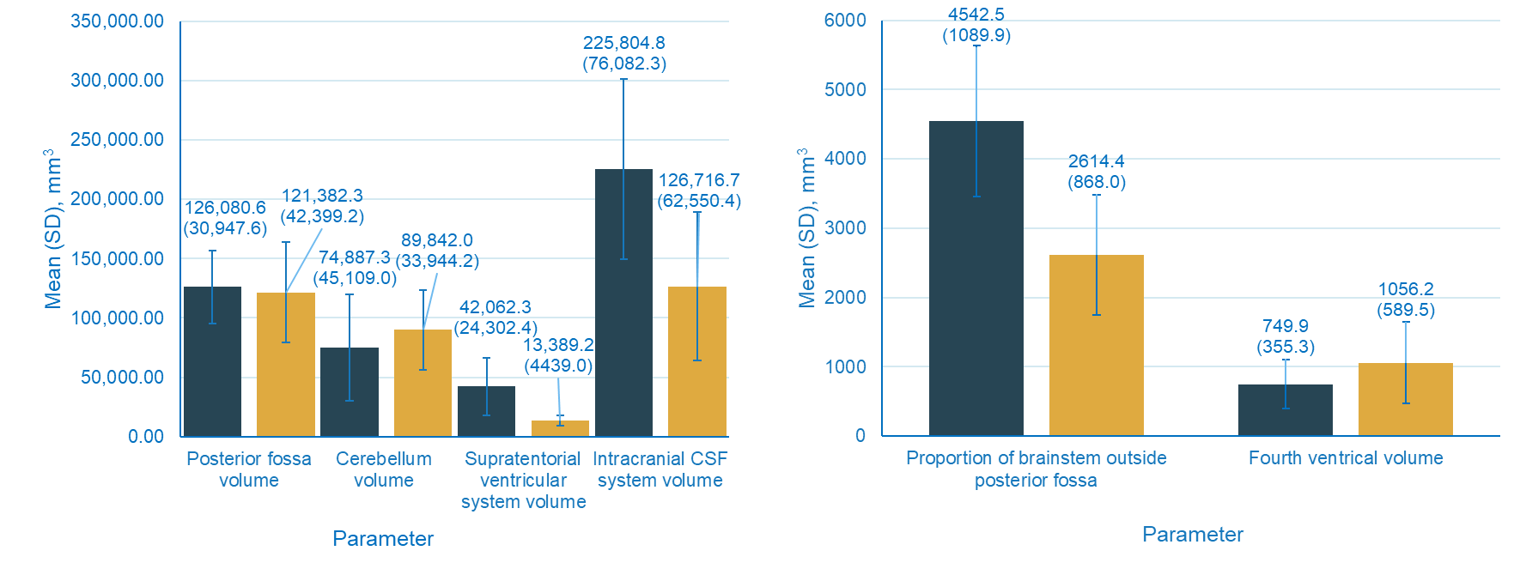
Anatomical characteristics of cervicomedullary compression on MRI scans in children with achondroplasia
FMS is recognised as one of the most common and serious complications associated with ACH in infancy and early childhood
This study aimed to expand upon the AFMS to identify further anatomical characteristics in children with ACH that may allow for the development of standardised indications for decompression surgery and a standardised evaluation of effect of medical treatment on critical intracranial structures
Data: children with ACH (≤4 years) with skull base MRI collected between Oct 2020 and Apr 2023 from Germany-wide CrescNet Registry at Magdeburg University Hospital
Reference data: children without ACH (≤4 years) with skull base MRIs provided by Magdeburg University Hospital
Preoperative MRI scans analysed using Dornheim Segmenter software
12 parameters measured using T1- and T2-weighted images*
AFMS calculated based on sagittal and axial T-2 weighted images from ACH group
MRI analysis of anatomical structures, in combination with the AFMS may provide a standardised indication for decompression surgery in children with ACH

Slide 3
Achondroplasia: aligning mouse model with human clinical studies shows crucial importance of immediate postnatal start of the therapy
Infigratinib* improves defective axial and appendicular growth in ACH mice
Early infigratinib treatment increased naso-anal length by 18.6±5.1%, L4-L6 length by 14.8±6%, and 18.4±8.9% versus untreated ACH mice
Femoral growth improved from 15.6±4.4% shorter to 2.0±2.5% (early treatment initiation) and 7.3±4.1% (late treatment initiation) shorter
Early infigratinib treatment restores defective head skeletogenesis in ACH mice
Early infigratinib treatment reduced the fronto-basal angle from 79.8±4.75° to 58.2±5.48°, whereas late treatment showed no significant effect (76.3±3.06°)
Early infigratinib treatment improved SOS fusion (51.9% early versus 17% late) but did not affect ISS
Foramen magnum area increased significantly with early treatment, whereas late treatment had no effect
Tibial growth improved from 20.6±4.1% shorter to 6.7±2.1% (early treatment initiation) and 13.1±4.1% (late treatment initiation) shorter
Cortical bone density and secondary ossification improved with infigratinib treatment
Early treatment produced a significantly larger effect than late treatment in the tibias (p = 0.022)
Early infigratinib treatment led to 93.5±11.1% rescue of cartilaginous tissue in the IOS, compared with a significantly weaker effect with late treatment (47.7±38.4%, p < 0.001)
The benefits of immediate postnatal ACH treatment have yet to be clearly demonstrated, and could take years to prove given the duration of clinical trials
This study compared ACH therapy given immediately after birth with therapy started later and identified the main benefits of immediate postnatal treatment in a preclinical mouse model of ACH
Study performed according to Masaryk University’s Institutional Animal Care and Use Committee guidelines
Mouse pups received SC injections of 1.5 mg/kg infigratinib at a volume of 10 ml/kg OD
Bone staining, μCT imaging, and morphometric analyses were performed for skull, tibia, and femur measurements
Mouse pup litters were randomly assigned into experimental and control groups, without distinction between males and females
This study provides evidence that immediate postnatal therapy is beneficial for improved skeletal growth and prevention of sequelae associated with ACH

Slide 4
Oral Infigratinib* Therapy in Children with Achondroplasia
Preclinical data in a mouse model of ACH showed infigratinib restored FGFR3 activity, and improved skeletal growth, and the size and shape of the foramen magnum versus untreated controls
The PROPEL2 Phase 2 trial evaluated safety and efficacy of oral infigratinib in children with ACH between the ages of 3 and 11 years
72 children with ACH enrolled in five sequential cohorts
Participants treated for 6 months
Primary safety outcome
Cohort 1 – 0.016mg/kg/day infigratinib
Cohort 2 – 0.032mg/kg/day infigratinib
Cohort 3 – 0.064 mg/kg/day infigratinib
Cohort 4 – 0.128 mg/kg/day infigratinib
Cohort 5 – 0.25 mg/kg/day infigratinib
Following 6 months treatment with infigratinib, 12 months extended treatment in which cohorts 1 and 2 escalated to next ascending level at months 6 and 12
Incidence of adverse effects that led to a decrease in dose or discontinuation of infigratinib
Primary efficacy outcome
Change from baseline in AHV
No. patients | 12 | 11 | 11
All patient experienced at least one AE during treatment
No patients had an SAE or grade 4 or 5 event
10% patients had TRAEs†
Oral infigratinib treatment did not result in any apparent major safety concerns and increased the AHV in children with ACH

