Slide 1
Achondroplasia.expert literature review
Persistent growth-promoting effects of vosoritide▼ in children with achondroplasia are accompanied by improvements in physical and social aspects of health-related quality of life
Adapted from: Savarirayan R, Irving M, Wilcox WR, Bacino CA, Hoover-Fong JE, Harmatz P, Polgreen LE, Mohnike K, Prada CE, Kubota T, Arundel P, Leiva-Gea A, Rowell R, Low A, Sabir I, Huntsman-Labed A, Day J
Genet Med. 2024. doi: 10.1016/j.gim.2024.101274. Epub ahead of print.
▼This medicinal product is subject to additional monitoring. This will allow quick identification of new safety information. Healthcare professionals are asked to report any suspected adverse reactions. The PI and AE reporting are available at the end of this slide deck.
Achondroplasia.expert is organised and funded by BioMarin. This material has been developed in conjunction with the Achondroplasia.expert Editorial Committee.
For Healthcare Professionals Only © 2024 BioMarin International Ltd. All Rights Reserved. EUCAN-VOX-00721 09/24

Slide 2
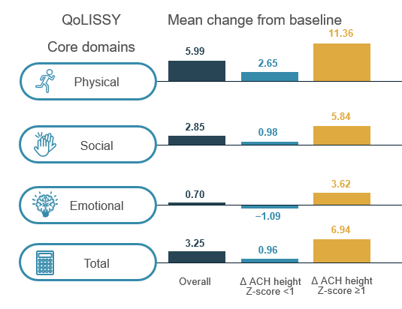
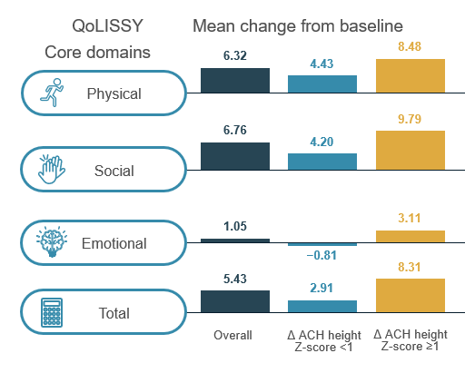
Persistent growth-promoting effects of vosoritide▼ in children with achondroplasia are accompanied by improvements in physical and social aspects of health-related quality of life
Increased AGV with vosoritide demonstrated in clinical trials
Caregiver and self-reported QoLISSY change from baseline to year 3 (week 156)
It is unknown whether children with ACH derive HRQoL benefits through the increased height and improved body proportionality achieved with vosoritide
This analysis focuses primarily on the results at 3-year follow up from an ongoing Phase 3 OLE study, with the aim of investigating the effect of vosoritide on HRQoL in children
Caregiver-reported
Self-reported
OLE study following Phase 3 placebo-controlled study
Vosoritide may improve self-reported and caregiver-reported QoLISSY physical and social scores compared to baseline, with the greatest increases being seen in participants with a ≥1 SD increase in height Z-score

Slide 3
ACH.expert VOXZOGO®▼ (vosoritide) Prescribing Information Slide

Slide 4
VOXZOGO®▼ (vosoritide) Prescribing Information
Achondroplasia.expert may contain promotional material on BioMarin products, which is displayed based on the prescribing information approved by the European Medicines Agency – EMA
Access the latest API: VOXZOGO®▼ (vosoritide)
Within your downloaded Zip File, you will find a copy of the latest Prescribing Information
The latest API can also be accessed on Achondroplasia.expert – Prescribing Information
The prescribing information must form part of the promotional material and must not be separate from it
Achondroplasia.expert Terms and Conditions

