Slide 1
Achondroplasia.expert literature review
May 2024
Achondroplasia.expert is organized and funded by BioMarin. This material has been developed in conjunction with the Achondroplasia.expert Editorial Committee.
For Healthcare Professionals Only © BioMarin 2024. All Rights Reserved. EUCAN-ACH-00220 07/24

Slide 2
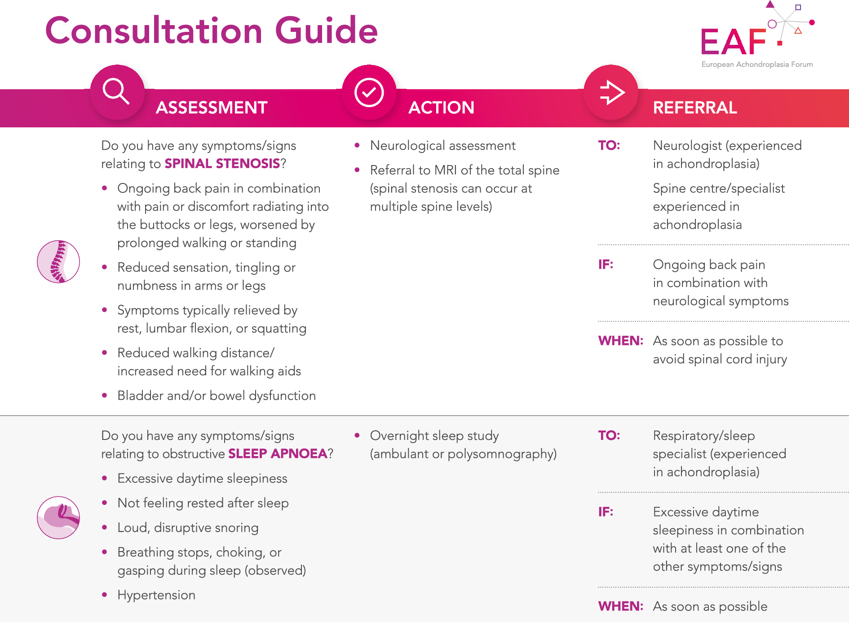
European Achondroplasia Forum practical considerations for following adults with achondroplasia
Background
Many people with achondroplasia are lost to follow-up both during and after the transition from paediatric to adult care
No standardised approach exists for the care of adults with achondroplasia
The checklist highlights key symptoms of spinal stenosis and OSA, both among the most frequent and potentially severe medical complications in adults with achondroplasia
The checklist also acts as a framework to support individuals and their primary care providers in completing a routine review, offering advice on issues such as blood pressure, pain, height, weight, adaptive aids and psychosocial aspects
This ensures the existing multidisciplinary team model in place during childhood can support in engaging individuals, allowing them to take responsibility for their own care as they progress into adulthood
The EAF checklist can aid young people with achondroplasia transitioning to adult care in understanding their condition, recognising key symptoms, and ensuring timely referrals to specialists

