Slide 1

Growth-promoting effects of vosoritide▼ in children with achondroplasia aged ≥10 years at treatment initiation: Results from a Phase 3 extension study
Adapted from: Savarirayan R, Tofts L, Irving M, Wilcox WR, Harmatz PR, Rutsch F, Carroll R, Polgreen LE, Mohnike K, Charrow J, Hoernschemeyer D, Ozono K, Kubota T, Alanay Y,
Arundel P, Yasui N, White KK, Brandstetter S, Saal HM, Mochizuki H, Tajima A, Basel D,
Mukherjee S, Harris M, Ingole S, Low A, Hoover-Fong JE
Presented at the Pediatric Endocrine Society’s 2024 Annual Meeting; May 2–5, 2024
▼This medicinal product is subject to additional monitoring. This will allow quick identification of new safety information.
Healthcare professionals are asked to report any suspected adverse reactions. The PI and AE reporting are available at the end of this slide deck.
Achondroplasia.expert is organized and funded by BioMarin. This material has been developed in conjunction with the Achondroplasia.expert Editorial Committee.
For Healthcare Professionals Only
© 2024 BioMarin International Ltd.
All Rights Reserved. EUCAN-VOX-00451 07/24

Slide 2
Background
Vosoritide has been shown to improve the height Z-score in children with achondroplasia aged 0–5 years* versus a placebo after 52 weeks treatment
Vosoritide has shown a statistically significant improvement in AGV in children with achondroplasia versus a placebo after 52 weeks treatment
An extension study showed the improvement in AGV was sustained after 2 years of vosoritide treatment
The efficacy and safety of vosoritide treatment in children aged 10 years or older is reported here

Slide 3
BMN 111-301/302 study design
Participants who completed a 52-week, Phase 3, placebo-controlled trial (BMN 111-301) were enrolled in an open-label extension study (BMN 111-302), where they continued to receive vosoritide
BMN 111-301
BMN 111-302
Vosoritide 15 µg/kg
n=60
Vosoritide 15 µg/kg*
n=58
Baseline growth natural history study
Placebo
n=61
Vosoritide 15 µg/kg*
n=61
52 weeks double-blind, 1:1
N=121
Ongoing, open-label,
final adult height
N=119

Slide 4
BMN 111-302 study disposition
49 participants received their first dose of vosoritide when they were ≥10 years of age*,
and efficacy was assessed using 12-month-interval AGV referenced to ACH untreated AGV and average-stature AGV. Safety was assessed with AE rate
31 continuing on treatment
BMN 111-302 extension study
49 participants treated at ≥10 years of age
13 continuing in study
18 discontinued treatment
5 discontinued in study
Participant request† (9)
Reached near-final adult height (6)
Adverse events (1)
Lost to follow-up (1)
Other (1)

Slide 5
Participant demographics
 | 301/302 (N=49)*
Age at day 1 of treatment (years)
Mean (SD) | 11.81 (1.32)
Min, max | 10.0, 15.9
Age subgroups (%)
≥10 to <11 years | 13 (26.5)
≥11 to <15 years | 35 (71.4)
≥15 to <18 years | 1 (2.0)
Sex (%)
Male | 24 (49.0)
Female | 25 (51.0)

Slide 6
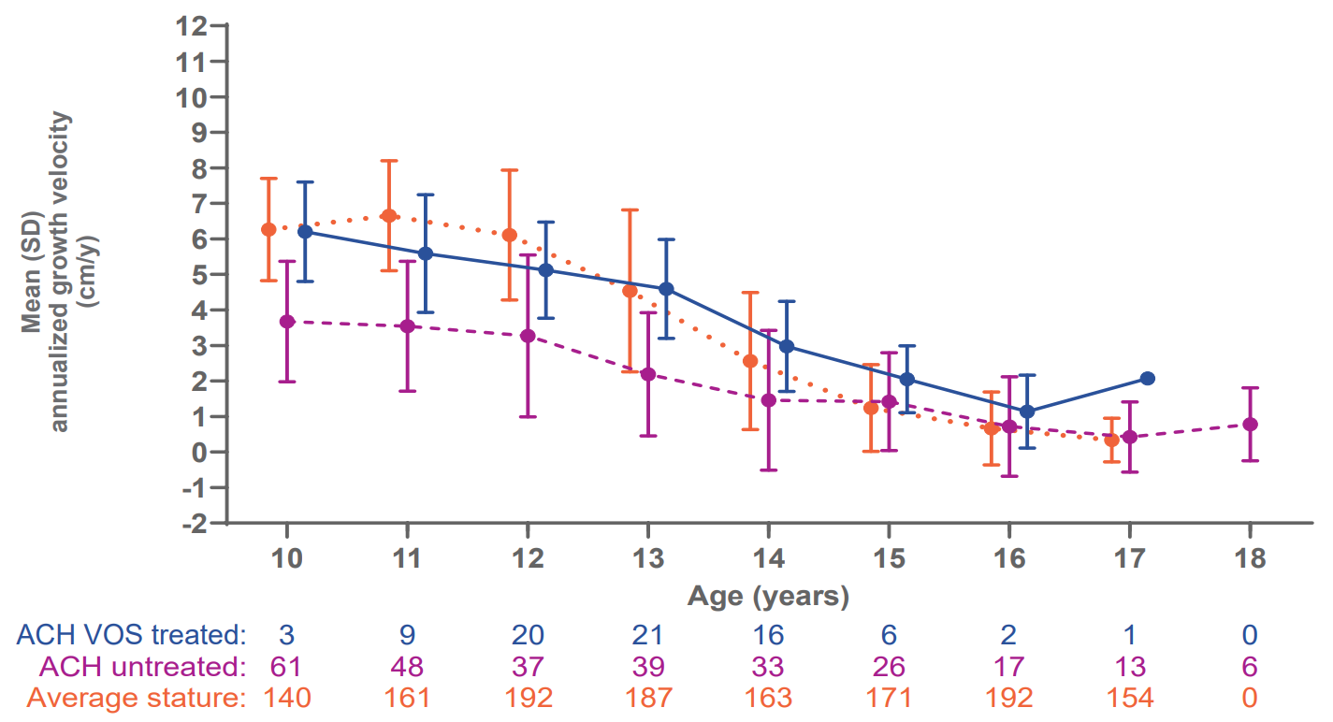
Age- and sex-specific AGVs: Females
Mean age- and sex-specific AGVs were consistently higher in children treated with vosoritide than in untreated controls across all age groups, with a mean difference of 1.47 (0.63) cm/y in females*

Slide 7
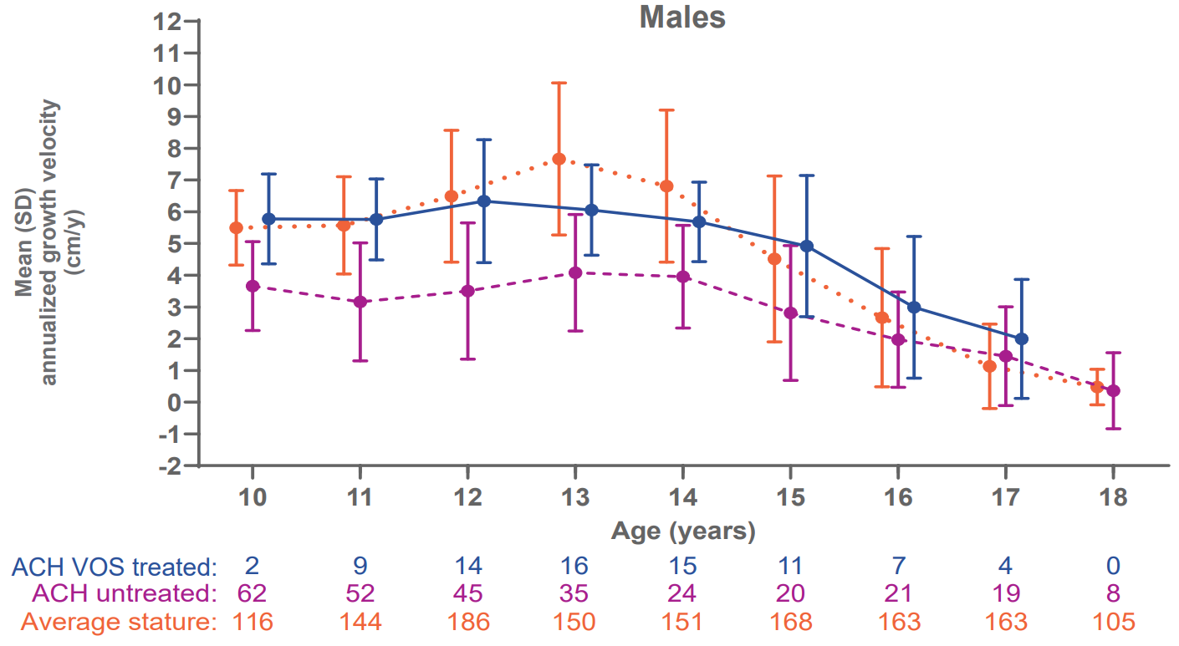
Age- and sex-specific AGVs: Males
Mean age- and sex-specific AGVs were consistently higher in children treated with vosoritide than in untreated controls across all age groups, with a mean difference of 1.71 (0.63) cm/y in males*

Slide 8
Tanner stages: Sex-specific AGV year
 | Tanner stages for females |  |  |  |  |  | Tanner stages for males
 | I | II | III | IV | V | Total | I | II | III | IV | V | Total
10 years | 1 |  | 2 |  |  | 3 | 2 |  |  |  |  | 2
11 years | 1 | 5 | 1 | 2 |  | 9 | 4 | 5 |  |  |  | 9
12 years |  | 4 | 8 | 7 | 1 | 20 | 3 | 3 | 8 |  |  | 14
13 years |  | 1 | 4 | 13 | 3 | 21 | 2 | 3 | 6 | 5 |  | 16
14 years |  |  | 2 | 5 | 9 | 16 |  | 4 | 2 | 6 | 3 | 15
15 years |  |  |  |  | 6 | 6 |  |  | 1 | 4 | 6 | 11
16 years |  |  |  | 1 | 1 | 2 |  |  |  | 2 | 5 | 7
17 years |  |  |  | 1 |  | 1 |  |  |  |  | 4 | 4
Growth benefits occurred regardless of the Tanner stage of the patients

Slide 9
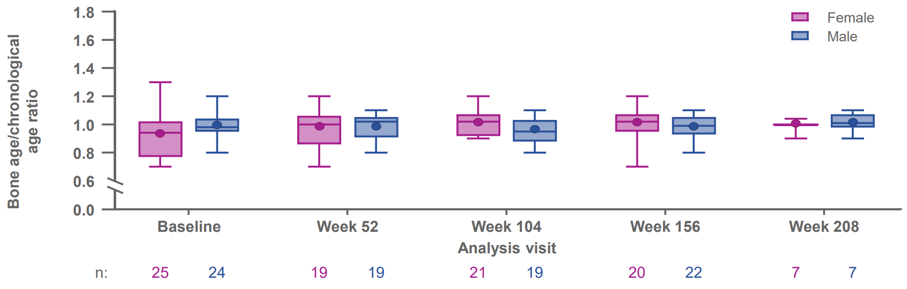
Bone age/chronological age ratio
Vosoritide treatment had no adverse effects on bone age in male or female children, and there was no evidence of acceleration of bone age with vosoritide

Slide 10
Safety summary
 | Overall N=49; 176.77 person-years
 | Incidence, n(%)* | Event rate (AEs/person-year)
AE Treatment-related AEs AEs leading to study drug discontinuation | 49 (100) 13 (26.5) 1 (2.0) | 656 (3.71) 37 (0.21) 1 (0.01)
SAEs Treatment-related SAEs SAEs leading to study drug discontinuation | 9 (18.4) 1 (2.0) 1 (2.0) | 11 (0.06) 2 (0.01) 1 (0.01)
AEs CTCAE grade ≥3 | 7 (14.3) | 10 (0.06)
Event of interest Injection site reactions CTCAE grade ≥2 Injection site reactions lasting >24 hours (excluding bruising) Hypotension Heart rate change Hypersensitivity (SMQ narrow terms) Avascular necrosis or osteonecrosis Slipped capital femoral epiphysis Fractures | 2 (4.1) 1 (2.0) 7 (14.3) 1 (2.0) 7 (14.3) 0 0 4 (8.2) | 5 (0.03) 11 (0.06) 9 (0.05) 1 (0.01) 14 (0.08) 0 0 5 (0.03)
Most AEs were mild and generally comparable to the experience of younger children

Slide 11
Conclusions
Vosoritide was well tolerated and improved AGV in children even when starting treatment at adolescence
AGV improvement persisted during the later stages of puberty
Growth benefits occurred regardless of the Tanner stage of the patients
Treatment with vosoritide was not associated with serious or treatment-limiting adverse drug reactions
  No pathological acceleration was observed in bone age

Slide 12
ACH.expert VOXZOGO®▼ (vosoritide)
Prescribing Information Slide

Slide 13
VOXZOGO®▼ (vosoritide) Prescribing Information
Achondroplasia.expert may contain promotional material on BioMarin products, which is displayed based on the prescribing information approved by the European Medicines Agency – EMA
Access the latest API: VOXZOGO®▼ (vosoritide)
Within your downloaded Zip File, you will find a copy of the latest Prescribing Information
  The latest API can also be accessed on Achondroplasia.expert – Prescribing Information
  The prescribing information must form part of the promotional material and must not be separate from it
Achondroplasia.expert Terms and Conditions

