Slide 1
Achondroplasia.expert literature review
April 2024
Achondroplasia.expert is organized and funded by BioMarin. This material has been developed in conjunction with the Achondroplasia.expert Editorial Committee.
For Healthcare Professionals Only © BioMarin 2024. All Rights Reserved. EUCAN-VOX-00452 07/24

Slide 2
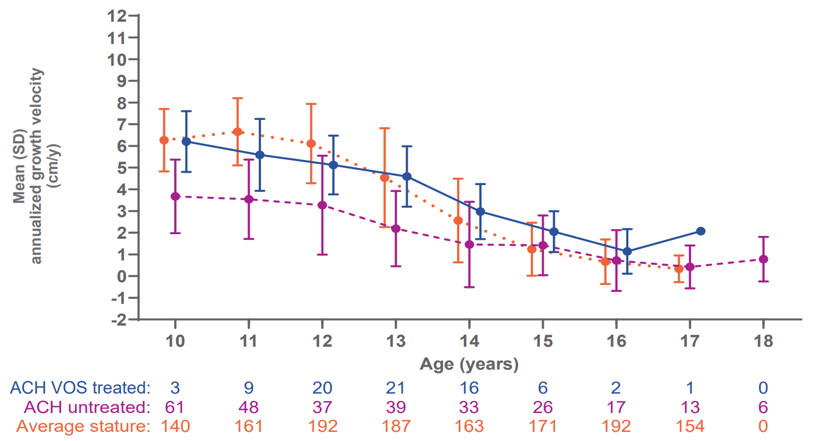
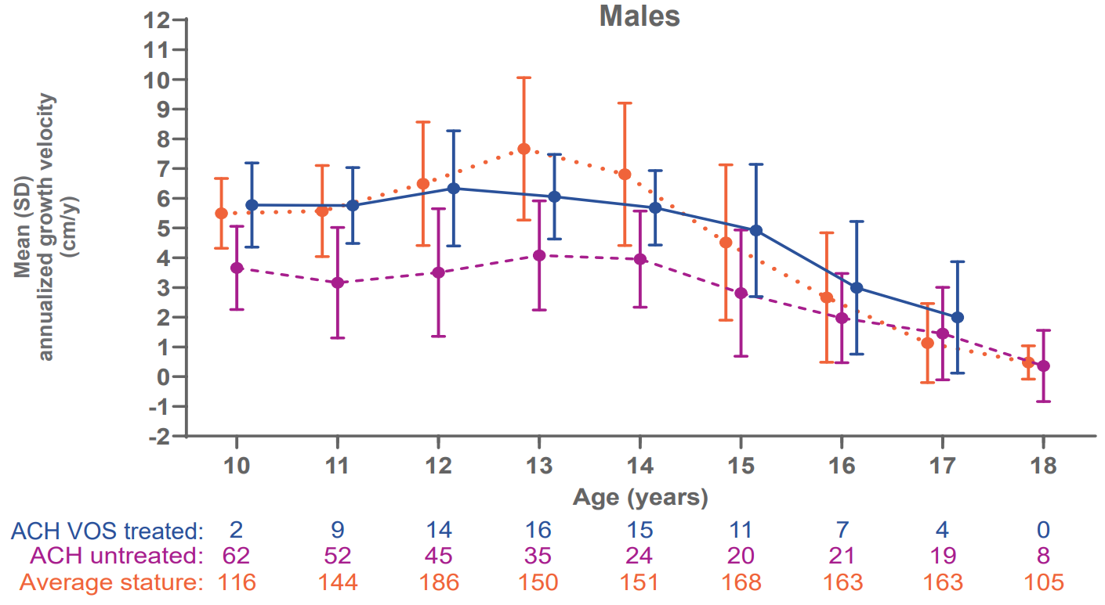
Growth-promoting effects of vosoritide▼ in children with achondroplasia aged ≥10 years at treatment initiation: Results from a Phase 3 extension study
Increase in growth for children with ACH was demonstrated with vosoritide in clinical trials
Age- and sex-specific AGVs in males and females
Females
Males
Vosoritide has been shown to improve height Z-score in children with achondroplasia aged 0–5 years* versus a placebo after 52 weeks
The efficacy and safety of vosoritide treatment in children aged 10 years or older is reported here
OLE study following a 52-week Phase 3 placebo-controlled trial
Efficacy was assessed using 12-month-interval AGV referenced to ACH untreated AGV and average-stature AGV
Safety was assessed with AE rate
Bone age/chronological age ratio
Vosoritide treatment had no adverse effects on bone age in male or female children
AGV improvement persisted during the later stages of puberty and growth benefits occurred regardless of Tanner stage
Vosoritide was well tolerated and improved AGV in children even when starting treatment at adolescence

Slide 3
New treatments for children with achondroplasia
Achondroplasia is the most common form of heritable SD with an estimated prevalence of 4–6 per 100,000 births.
Other therapies in clinical development
From early infancy, medical complications can occur that necessitate regular monitoring to manage and detect clinical symptoms
This review outlines new and emerging therapies targeting the underlying parthenogenesis of achondroplasia
Long-acting form of CNP: Navepegritide (Ascendis)
Phase 2 completed and administered as QD SC injection
FGFR1–3 inhibitor: Infigratinib (QED)
Phase 2 completed and administered as QD oral tablets
Soluble form of FGFR3: Recifercept (Pfizer)
Phase 2 trial ceased and administered as SC injection
FGFR3 monoclonal antibody: SAR442501 (Sanofi)
Ongoing lead-in growth study; administered as BIW SC injection
Histamine receptor 1 blocker: Meclizine
Phase 1a and administered orally once and twice per day
FGF2 inhibitor: RBM-007 (Ribomic)
Phase 1 RNA aptamer; administered via weekly SC injections
Approved therapies
Precision treatment: Vosoritide (BioMarin)
Initially approved by the EMA in August 2021
CNP analogue administered by QD SC injection
Blocks gain-of-function FGFR3 signal at RAF1
Approved for use in infants 4 months of age and older whose epiphyses are not closed
Multiple treatments are in development for children with achondroplasia, but ongoing long-term studies are needed to outline safety and efficacy measures beyond linear growth, aiming to improve QoL and the surgical and medical burden of achondroplasia

Slide 4
ACH.expert VOXZOGO®▼ (vosoritide) Prescribing Information Slide

Slide 5
VOXZOGO®▼ (vosoritide) Prescribing Information
Achondroplasia.expert may contain promotional material on BioMarin products, which is displayed based on the prescribing information approved by the European Medicines Agency – EMA
Access the latest API: VOXZOGO®▼ (vosoritide)
Within your downloaded Zip File, you will find a copy of the latest Prescribing Information
The latest API can also be accessed on Achondroplasia.expert – Prescribing Information
The prescribing information must form part of the promotional material and must not be separate from it
Achondroplasia.expert Terms and Conditions

