Slide 1
Achondroplasia.expert Literature Review
November & December 2022
Achondroplasia.expert is organized and funded by BioMarin. This material has been developed in conjunction with the Achondroplasia.expert Editorial Committee.
For Healthcare Professionals Only © 2025 BioMarin International Ltd. All Rights Reserved. EU-ACH-00761 01/25

Slide 2
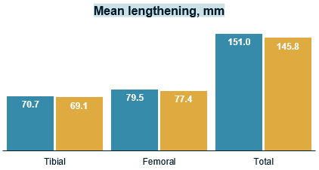
Does the Technique of Limb Lengthening Affect Physeal Growth in Patient With ACH? Comparison of the Simultaneous and Consecutive Tibia and Femur Lengthening With External Fixators
LL has become a standard treatment for ACH
The effect of lower extremity lengthening on physeal growth is still controversial
Aim: To compare physeal growth with bilateral simultaneous and consecutive LL surgery of the femur and tibia
Authors hypothesized that simultaneous LL affects physeal growth to a greater extent
Retrospective study
LL performed between 1995 and 2015
Followed until 18 years of age
Physeal arrest measured with:
Predicted final length at first visit
Total amount of lengthening
Final clinical and radiological length
Mean LL for simultaneous and consecutive groups was 145 mm (48.5%) and 151 mm (46.6%), respectively
There was no statistical difference, however, simultaneous bilateral femoral and tibial lengthening has more physiological physeal disturbance effects than consecutive lengthening in patients with ACH

