Slide 1
Achondroplasia.expert Literature Review
November & December 2022
Achondroplasia.expert is organized and funded by BioMarin. This material has been developed in conjunction with the Achondroplasia.expert Editorial Committee.
For Healthcare Professionals Only © 2022 BioMarin International Ltd. All Rights Reserved. EU-ACH-00761 01/23

Slide 2
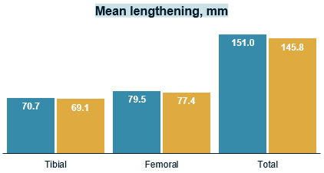
Does the Technique of Limb Lengthening Affect Physeal Growth in Patient With ACH? Comparison of the Simultaneous and Consecutive Tibia and Femur Lengthening With External Fixators
LL has become a standard treatment for ACH
The effect of lower extremity lengthening on physeal growth is still controversial
To compare physeal growth with bilateral simultaneous and consecutive LL surgery of the femur and tibia
Hypothesize that simultaneous LL affects physeal growth to a greater extent
Retrospective study
LL performed between 1995 and 2015
Followed until 18 years of age
Physeal arrest measured with:
Predicted final length at first visit
Total amount of lengthening
Final clinical and radiological length
Mean LL for simultaneous and consecutive groups was 145 mm (48.5%) and 151 mm (46.6%), respectively
There was no statistical difference, however, simultaneous bilateral femoral and tibial lengthening has more physiological physeal disturbance effects than consecutive lengthening in patients with ACH

