Slide 1
Achondroplasia.expert Literature Review
February 2023
Achondroplasia.expert is organized and funded by BioMarin. This material has been developed in conjunction with the Achondroplasia.expert Editorial Committee.
For Healthcare Professionals Only © 2022 BioMarin International Ltd. All Rights Reserved. EU-ACH-00773 04/23

Slide 2
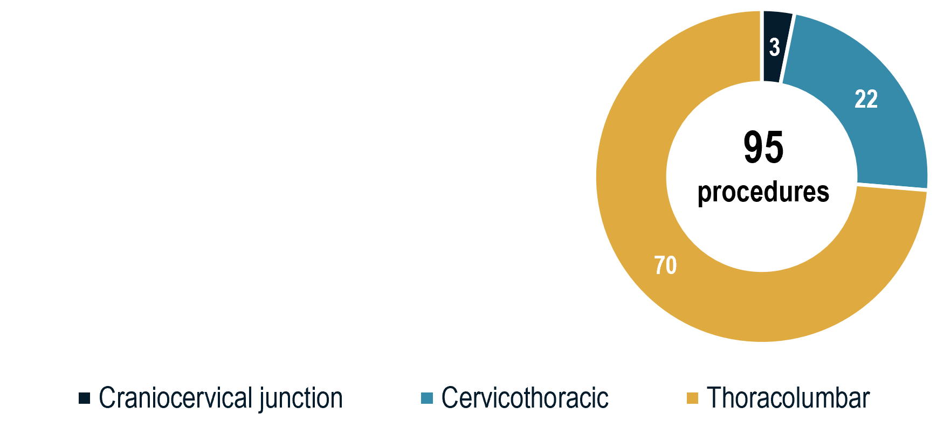
Perioperative Complications Following Spine Surgery in Adult Patients with ACH
ACH patients may develop spinal stenosis, leading to spinal cord and/or cauda equina compression
Key findings:
20–50% of adults with ACH have symptomatic spinal stenosis, and up to 78% of those have neurologic sequelae
ACH patients are at increased risk for complications during surgical intervention
Those undergoing surgery chronologically later in this set of consecutive patients had decreased complication risk
TL surgeries had the greatest risk for durotomies
Male sex was a risk factor for durotomy, while age was a risk factor for neurologic deficit
Retrospective cohort study
One institution in the USA
55 participants >16 years
58% female
Mean age: 44 years
Mean BMI: 35
LOS: 6.5 days
Complications by surgical region (%):
Potential for surgical AEs should be considered when evaluating patients with ACH for spine surgery

Slide 3
Assessment of Body Fat Mass, Anthropometric Measurement and Cardiometabolic Risk in Children and Adolescents With ACH and HCH
Epidemiological studies reveal premature onset of CV or cerebrovascular events in ACH
50% had ≥1 cardiometabolic abnormality
HCH is an allelic disease of ACH, but it is unclear whether these patients are susceptible to obesity
For some patients, excess body weight is a major concern due to impaired linear growth
Most common abnormality: elevated SBP
Retrospective cross-sectional study
One outpatient clinic in Japan
Children aged 1.9 to 18.7 years
Anthropometric measurements collected
DXA to measure body fat and lean mass
BMI-SDS and hip/height ratio were strongly correlated with percent body fat
There was no significant association between anthropometric measurements or body fat mass and any cardiometabolic risk factors
These results suggest that not only weight and hip/height changes should be monitored, but also individual risk factors to avoid cardiometabolic events in paediatric patients with ACH or HCH

