Slide 1
The First European Consensus on Principles of Management for Achondroplasia
Adapted from: Valerie Cormier‑Daire, Moeenaldeen AlSayed, Tawfeg Ben‑Omran, Sérgio Bernardo de Sousa, Silvio Boero, Svein O. Fredwall, Encarna Guillen‑Navarro, Melita Irving, Christian Lampe, Mohamad Maghnie, Geert Mortier, Zagorka Peijin and Klaus Mohnike
Orphanet J Rare Dis 2021;16:333.
Achondroplasia.expert is organized and funded by BioMarin. This material has been developed in conjunction with the Achondroplasia.expert Editorial Committee.
© 2021 BioMarin International Limited. All Rights Reserved. EU-ACH-00191 09/21

Slide 2
The European Achondroplasia Forum
EAF
Paediatric endocrinologists
Clinical geneticists
Orthopaedic surgeons
Neuro-paediatrician
GP specialised in achondroplasia
Representative of the specialities managing achondroplasia, from:
Belgium
France
Germany
Italy
Kingdom of Saudi Arabia
Norway
Portugal
Qatar
Spain
UK

Slide 3
The Process of Defining Guiding Principles
EULAR standard operating procedures consulted
Suggestions submitted, collated and grouped
Draft principles developed, and literature reviewed
Principles scrutinised in detail
Anonymous live voting

Slide 4
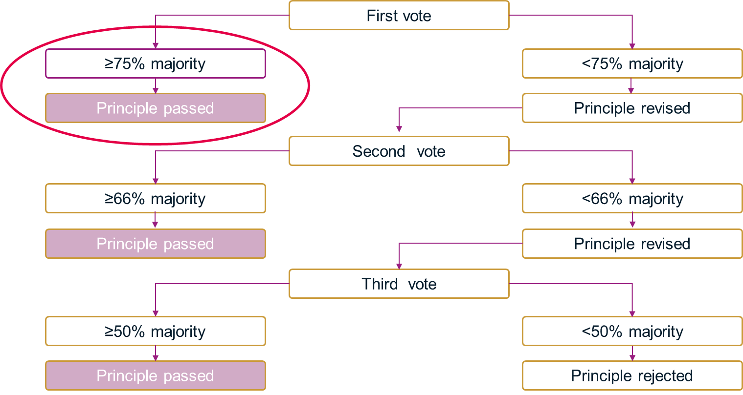
Voting Process All Principles Achieved 75% Majority on First Vote

Slide 5
The 2020 EAF Guiding Principles of Management for Achondroplasia
Item | Guiding principle | Vote (%) | Agreement (mean; range)
A | Achondroplasia is a lifelong condition requiring lifelong management by an experienced MDT, led by physicians/clinicians experienced in achondroplasia management. Close monitoring during the first two years of life is critical | 92 | 8.9 (8–10)
B | When a diagnosis of achondroplasia is made or suspected, either in utero or after birth, the family should be referred as soon as possible to a physician experienced in achondroplasia to discuss the prognosis and management of the condition | 100 | 9.3 (8–10)
C | Decisions around management should be made in the MDT setting jointly with the person with achondroplasia and/or their family | 100 | 9.6 (7–10)
D | The primary goals of management are to enable anticipation, identification and treatment of problems, provide education and support to encourage a healthy lifestyle, positive self-esteem and mental health, autonomy and independence | 100 | 9.2 (8–10)
E | Patients should have access to a variety of adaptive measures, support to ensure proper usage and access to approved treatment options as they become available | 91 | 8.5 (5–10)
F | Regular monitoring in adolescence and adulthood should continue under an MDT with expertise in achondroplasia management. Care should include genetic counselling, transition to adulthood, psychosexual well-being and management of pregnancy | 100 | 9.3 (8–10)

Slide 6
Conclusions
Guiding principles cover lifelong care for people with achondroplasia
Guiding principles of management can be implemented in any healthcare system
Implementation will provide a basis for developing optimal care
There is ongoing collaboration to scrutinise individual aspects of care
Principles of management for achondroplasia will be reviewed in 3–4 years, or when there are developments in the field that may change clinical practice

