Slide 1
C-Type Natriuretic Peptide Analogue Therapy in Children with Achondroplasia
Adapted from Savarirayan R, Irving M, Bacino CA, Bostwick B, Charrow J, Cormier‑Daire V, Le Quan Sang K-H, Dickson P, Harmatz P, Phillips J, Owen N, A Cherukuri A, Jayaram K, Jeha GS, Larimore K, Chan M-L, Huntsman Labed A, Day J, Hoover‑Fong J
N Engl J Med 2019;381(1):25–35
DOI: 10.1056/NEJMoa1813446
Achondroplasia.expert is organized and funded by BioMarin. This material has been developed in conjunction with the Achondroplasia.expert Editorial Committee.
For Healthcare Professionals Only © 2022 BioMarin International Ltd. All Rights Reserved. EU-VOX-00242 01/22

Slide 2
Background
VOXZOGO®▼(vosoritide) is a biologic analogue of C-type natriuretic peptide ⁽¹⁾
A potent stimulator of endochondral ossification
Once-daily vosoritide promotes long-bone growth in juvenile, skeletally normal mice and monkeys, and corrects the dwarfism phenotype in mice with achondroplasia ⁽¹⁾
This multinational, Phase 2, dose-finding and extension study evaluated the safety and side-effect profile of vosoritide in children with achondroplasia ⁽¹⁾

Slide 3
Study Design
35 children with a mean age of 7.6 years received subcutaneous vosoritide in four sequential cohorts:
Cohort 1 (n=8): 2.5 μg / kg QD; increased to 7.5 μg / kg after 6 months, then 15.0 μg / kg
Cohort 2 (n=8): 7.5 μg / kg QD; increased to 15.0 μg / kg after 6 months
Cohort 3 (n=10): 15.0 μg / kg QD
Cohort 4 (n=9): 30.0 μg / kg QD
Primary objectives were to evaluate the safety and side-effect profile and to determine the dose to further investigate in Phase 3 studies
Secondary objectives included:
Changes from baseline in AGV, height Z score, and body segment proportionality
The pharmacokinetic profile and biomarkers of drug activity and endochondral ossification

Slide 4
Results: Adverse Events and Safety Profile During the Dose-Finding and Extension Studies
No deaths occurred
AEs occurred in 100% of patients, SAEs occurred in 11% of patients
No AEs related to disproportionate skeletal growth or clinically significant adverse cardiovascular effects were observed
No Grade 3 or higher hypersensitivity reactions
No patients reported adverse events that were consistent with the criteria for anaphylaxis
ADA responses were detected in 40% of patients at one or more assessment visits
Among the 14 patients with ADA, serum total antibody titres were transient in 7, declining to undetectable levels, but sustained in the other 7 patients at the end of the dose-finding study
Neutralising antibodies were detected in 2 patients at a single visit
No association between ADA-positivity and hypersensitivity or injection-site reactions
Subcutaneous vosoritide was associated with a generally mild side-effect profile

Slide 5
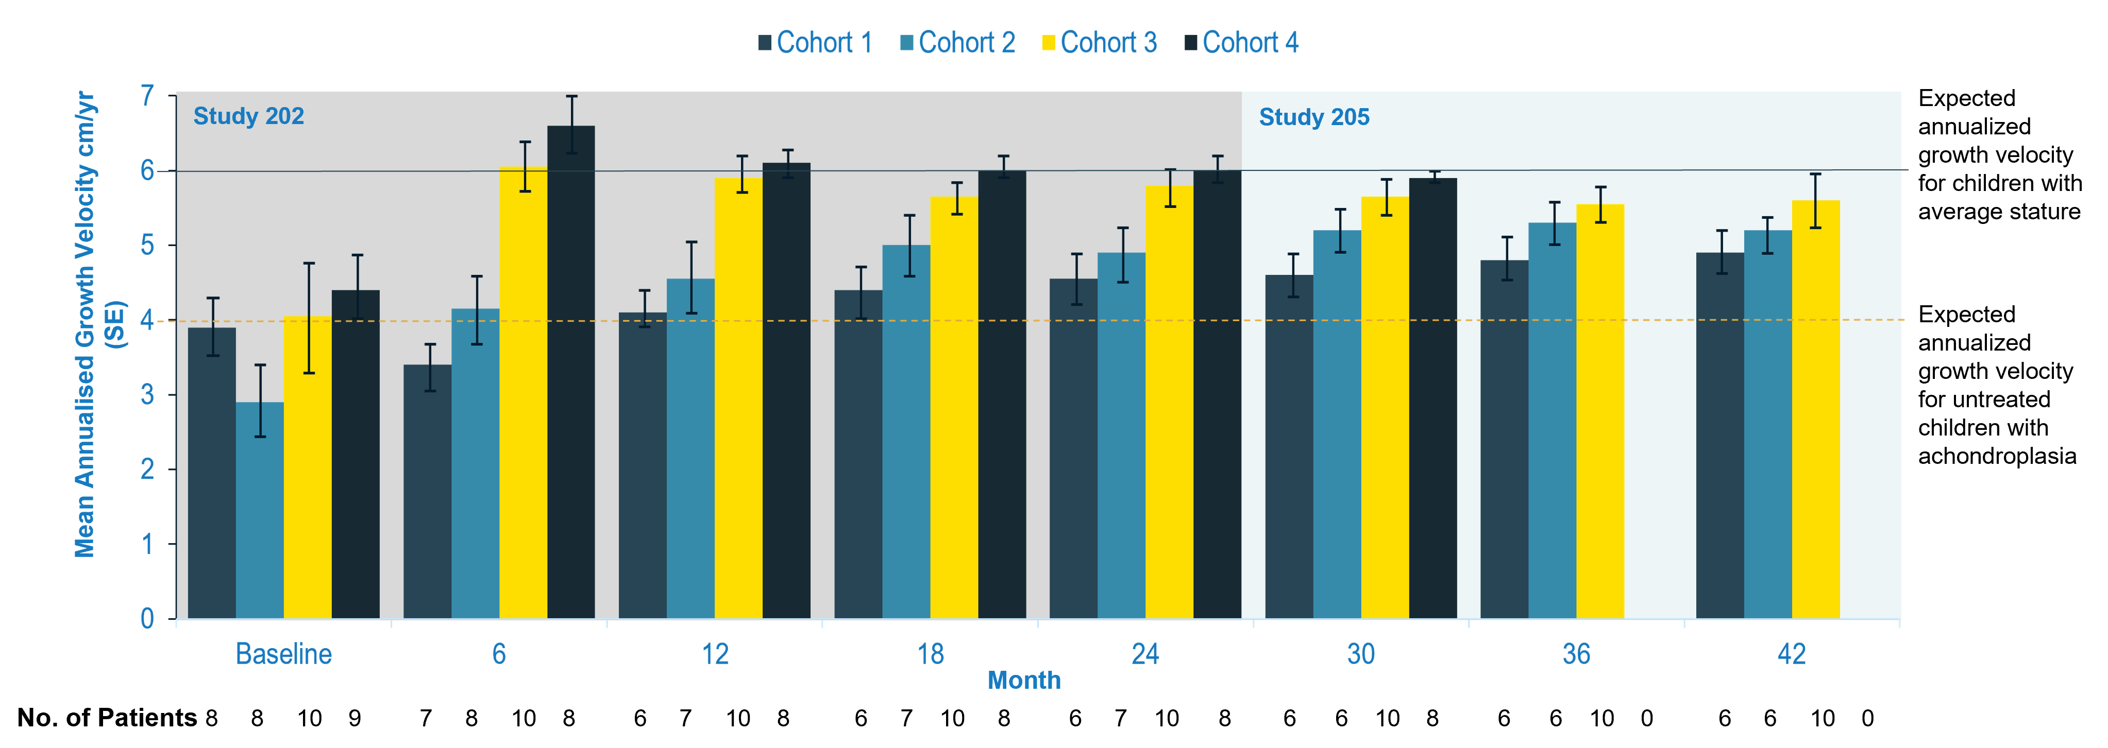
Results: Mean Annualised Growth Velocity
Dose-dependent increase in AGV observed at 15.0 μg/kg over first 6 months; AGV increase sustained for up to 42 months

Slide 6
Results: Mean z Scores for Height at Baseline and During Treatment
Dose-dependent increases in z scores for height were observed in patients receiving doses of up to 15 μg / kg
There was no further increase at 30 μg / kg
Height z scores continued to improve over 42 months after treatment
In contrast to the decline during the 12 month observational pre-treatment period
Positive regression line slopes indicate height improvements in all cohorts

Slide 7
Results: Mean Change from Baseline in cGMP and CXM Concentration
On day 1 of treatment, dose-dependent increases from baseline in urinary cGMP were observed at 6 months for all treatment doses and sustained for up to 24 months of treatment
Serum CXM is a specific biomarker of endochondral ossification
Median serum CXM concentrations remained elevated relative to baseline in all cohorts from 12 through 24 months
Maximum responses were observed in the 15 μg / kg and 30 μg / kg dose cohorts
Increased biomarker concentrations over first 6 months remained through 24 months

Slide 8
Conclusion
Treatment resulted in a sustained increase in annualised growth velocity for up to 42 months
With corresponding dose-dependent increases in biomarker concentrations
Height z scores continued to improve over 42 months
The side-effect profile of once-daily subcutaneous vosoritide appeared mild
No difference in efficacy or safety could be identified between the 15.0 μg / kg and 30.0 μg / kg doses
These findings support the choice of the lower dose for further evaluation in ongoing studies

Slide 9
VOXZOGO®▼ (vosoritide) Prescribing Information
Achondroplasia.expert may contain promotional material on BioMarin products, which is displayed based on the prescribing information approved by the European Medicines Agency – EMA
Access the latest API: VOXZOGO®▼ (vosoritide)
Within your downloaded Zip File, you will find a copy of the latest Prescribing Information
The latest API can also be accessed on Achondroplasia.expert – Prescribing Information
The prescribing information must form part of the promotional material and must not be separate from it
Achondroplasia.expert Terms and Conditions

