Slide 1

Experiences of Children and Adolescents Living
With Achondroplasia and Their Caregivers
Adapted from: Shediac R, Moshkovich O, Gerould H, Ballinger R, Williams A, Bellenger MA,
Quinn J, Hoover-Fong J, Mohnike K, Savarirayan R, Kelly D
Mol Genet Genomic Med 2022;e1891
doi:10.1002/mgg3.1891
Achondroplasia.expert is organized and funded by BioMarin. This material has been developed in conjunction with the Achondroplasia.expert Editorial Committee.
For Healthcare Professionals Only
© 2022 BioMarin International Ltd.
All Rights Reserved. EU-ACH-00429 04/22

Slide 2
Background
ACH leads to significant multisystem complications across the lifespan, which may affect the HRQoL of individuals and families living with the condition
It is important to understand current experiences within ACH communities in order to improve the quality of care of affected individuals, and to inform clinical practice guidelines
This qualitative study aimed to describe the HRQoL of children and adolescents
with ACH and their caregivers

Slide 3
Methods
Participants were recruited from the US and Spain – two countries with divergent approaches to certain aspects of ACH management
  For example, surgical limb lengthening is common in Spain but rarely performed in the US
34 caregivers and 12 adolescents participated in a focus group or completed an individual interview, which was audio-recorded and transcribed
  In each country, there were 4 focus group discussions for adolescents (13–17 years) with ACH, and the caregivers of children/adolescents with ACH aged 0–4, 5–12, and 13–17 years
  3 1-on-1 telephone interviews with US adolescents were conducted due to low group attendance
Focus group discussions were held around three topics in three 90-minute sessions:
  Understanding the impact of ACH on individuals’ and caregivers’ lives
  Perceptions of risk, benefits, and other important aspects of treatments
  Understanding the clinically meaningful changes in height, proportionality, independence with activities of daily living, and changes in three HRQoL scores*
Thematic analysis of qualitative data was performed to identify common HRQoL themes

Slide 4
Example of Discussion Guide Questions
Topic | Caregiver discussion guides | Adolescent discussion guide
Physical impacts | In terms of any physical impacts, please can you describe how ACH impacts physical functioning and say a little about how these impact your child's daily life? | In terms of any physical impacts, please can you describe how ACH affects your physical functioning and say a little about how these impact your daily life?
Activities of daily living | Ages 0–4: Does ACH affect your child's ability to do activities appropriate for their age? Ages 5–17: Is your child able to manage their self-care in relation to going to the toilet, washing, and dressing? (If no, do you think this will change?) | Are you able to manage your own self-care? (going to the toilet, washing, and dressing)
Social impacts | Have there been any social impacts for your child due to ACH? (How is school life for your child? How do any challenges impact your child?) | Are you affected socially because you have ACH? (How is school life for you? How do any challenges affect you?)
Medical care | Tell me about your experiences with medical care for your child (Does your child have any routine follow-up appointments related to ACH? If so, how often?) (Do you have a medical provider who understands how to treat children with ACH?) | Tell me about your experiences with medical care (Do you have any routine follow-up appointments related to ACH? If so, how often?) (Do you have a medical provider who understands how to treat individuals with this condition?)
Impacts on family | Do you think there are specific impacts in having a child with ACH on the family overall? | Not asked
Treatments | Before we discuss specific types of treatments, it would be useful to know in general what you think about medical treatment for this condition (Have your thoughts on this changed over time at all? If so, why? What led to this change?)

Slide 5
Experiences of Children and Adolescents, as Reported by Themselves and Their Caregivers

Slide 6
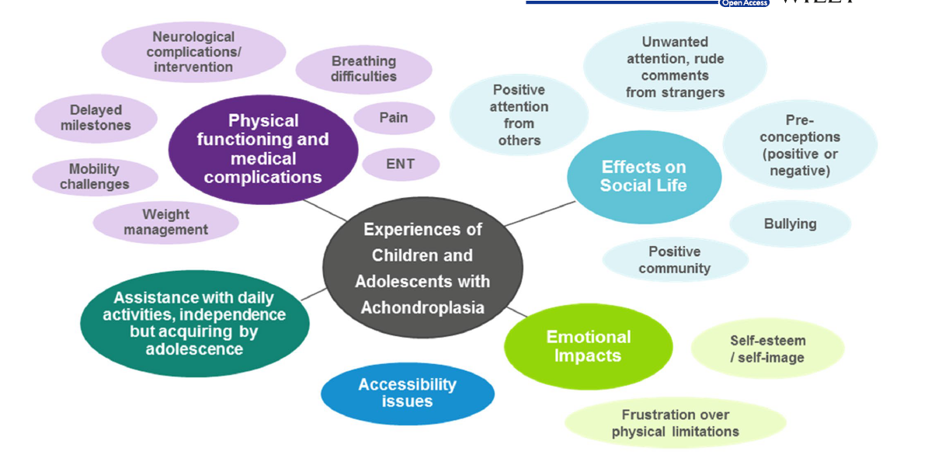
Themes and Sub-Themes of the Experiences of Children and Adolescents With ACH (ages 0–17)
Key challenges included difficulties performing activities of daily living, issues of accessibility, bullying, unwanted attention in public, and negative effects on self-esteem

Slide 7
Physical Functioning and Related Complications
All caregivers reported a delay in early physical developmental milestones, such as holding up the head, walking, crawling, and sitting up
Caregivers of all age groups discussed mobility limitations and challenges
  For example, balance issues that affect walking ability
Participants reported physical complications of achondroplasia
  For example, stenosis/spinal compression, breathing and sleeping difficulties, pain, weight management, and otolaryngological issues
Participants frequently reported pain that limited physical functioning and stamina
All caregivers reported a delay in early physical developmental milestones

Slide 8
Challenges and Difficulties in Acquiring
Independence in Activities Of Daily Living
Caregivers discussed the challenges and the need for more assistance with activities of daily living for children with ACH than with their other children or peers
Caregivers and adolescents most frequently mentioned needing assistance with toileting
  Difficulties with tasks related to personal hygiene were noted as a challenge; however, participants also noted improvements with age
Performing activities of daily living may improve as children with ACH get older

Slide 9
Accessibility Challenges and Adaptations
All participants spoke of modifications and adaptations made at home to increase accessibility, although the cost and level of modification varied
By adolescence, as individuals become more independent and home adaptations are in place, most challenges of accessibility are outside of the home (e.g., public bathrooms, hotels, restaurants, and grocery stores)
Adolescents frequently mentioned impacts on their social activities, such as being excluded from theme park rides due to height requirements or difficulty seeing over crowds
Home modifications and adaptations are needed for children and adolescents with ACH

Slide 10
Social Impacts of Achondroplasia
Negative social impacts:
Receiving rude comments and unwanted attention in public
Being bullied at school
Not being invited to participate in activities
Perceived to be younger than their true age or less capable
Positive social impacts:
Being popular at school due to their unique size
Good support systems and events
A range of social experiences was described

Slide 11
Emotional Effects of Living With Achondroplasia
The negative emotional impacts of living with ACH included hurt feelings,
loss of self-esteem, and frustration or anger
For the youngest age group (0–4 years), feelings of frustration appear to stem from physical limitations and comparing their abilities to their peers
In Spain, caregivers reported that their children felt frustrated and angry when they were unable to reach items, such as door handles, light switches, and the intercom
ACH can have an impact on emotions everyday

Slide 12
Decision-Making and Perceptions of Limb Lengthening Treatment
Among the Spanish adolescents, 2 had already undergone limb lengthening surgery, 2 were currently considering surgery, and 2 had decided not to have surgery
  The 2 who had undergone surgery acknowledged the pain and challenges of recovery
  1 adolescent spoke positively about the results of surgery, especially the gain in stature
  The 2 who had completed surgery reported greater independence in daily activities, such as reaching items or maintaining personal hygiene
In the US groups, none of the participants or their children had undergone or considered undergoing limb lengthening surgery, which was generally perceived as intrusive, extremely painful, requiring a long recovery, and unnecessarily risky
There are country-specific differences in the experiences around limb lengthening

Slide 13
Experiences of Caregivers and Families

Slide 14
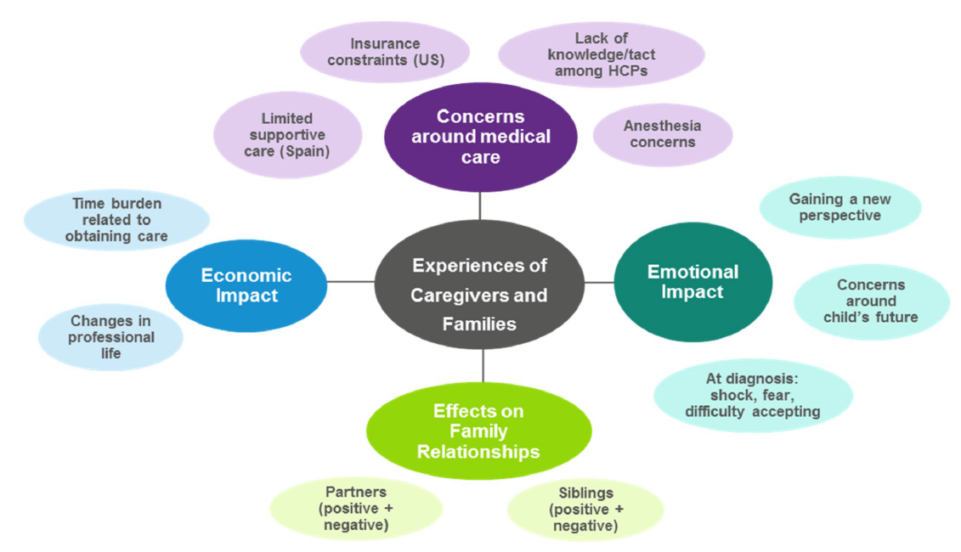
Themes and Sub-Themes of Caregivers' and Families’ Experiences
Caregivers were concerned about accessing appropriate medical care for their child, and also reported experiencing financial, relational, and emotional challenges in their families

Slide 15
Concerns Around Access to Appropriate Medical Care and Economic Impacts
Caregivers frequently mentioned a lack of confidence in providers, the challenge of accessing specialist care, and the economic burden of medical care
  In both countries, participants voiced concern about medical providers' lack of knowledge
  Caregivers also reported a wide range of providers' efforts to gain or ensure they had appropriate knowledge and understanding of ACH
Many participants reported that access to care was a challenge, often due to insurance
or location
Caregivers discussed indirect costs due to the amount of time needed to ensure their child received the necessary medical care
Some caregivers reported modifying their work schedule or the need for flexibility to accommodate the numerous medical appointments required in the early years of ACH
Challenges regarding their child's medical care were the most discussed parental impacts

Slide 16
Effects of Achondroplasia on Family Relationships
Caregivers reported that having a child with ACH could strain their marriage or partnership, whilst others reported that having a child with ACH strengthened the family bond
  Some challenges arise specifically during the child's early years, with disagreements regarding treatment and supportive services or groups
  Others noted stress arising from having a child who is in pain
Caregivers discussed the negative and positive impacts on the family
  Some reported that siblings felt jealous of the attention the child with ACH received
  Others reported their average stature children are protective of their sibling with ACH
Family relationships can be affected by ACH

Slide 17
Conclusions
Caregivers and adolescents described physical functioning challenges and medical complications due to ACH
  Key challenges included activities of daily living, accessibility, bullying, unwanted attention
  in public, and negative effects on self-esteem
  Caregivers were concerned about accessing medical care for their child, and also reported financial, relational, and emotional challenges
ACH also affected individuals and their families in positive ways
  Including increasing empathy, receiving positive attention, and feeling supported
  by the ACH community
These findings underscore the importance of regular assessments of HRQoL and the provision of psychosocial support for affected children and families

