Slide 1
Craniofacial growth and function in achondroplasia: a multimodal 3D study on 15 patients
Adapted from: Morice A, Taverne M, Eché S, Griffon L, Fauroux B, Leboulanger N, Couloigner V, Baujat G, Cormier-Daire V, Picard A, Legeai-Mallet L, Kadlub N, Khonsari RH
Orphanet J Rare Dis. 2023;18(1):88
doi: 10.1186/s13023-023-02664-y
Achondroplasia.expert is organised and funded by BioMarin. This material has been developed in conjunction with the Achondroplasia.expert Editorial Committee.
For Healthcare Professionals Only © 2023 BioMarin International Ltd. All Rights Reserved. EU-ACH-00807 07/23

Slide 2
Background
Achondroplasia (ACH) is the most frequent FGFR3-related chondrodysplasia, leading to:
Rhizomelic dwarfism
Craniofacial anomalies
Stenosis of the foramen magnum
Sleep apnoea
Craniofacial growth and its correlation with obstructive sleep apnoea syndrome has not been assessed in achondroplasia
This study aimed to better characterise and quantify the skeletal craniofacial phenotype in ACH patients*
The relationship between craniofacial shape and sleep study parameters was also investigated

Slide 3
Method: Study Design
Retrospective, multimodal study based on a paediatric cohort of ACH participants
ACH patients with confirmed FGFR3 gain-of-function mutations (N=15)
Analyses performed before any skeletal craniofacial procedure, including orthodontic treatments
Clinical and orthodontics evaluation and photographs
Respiratory
PG results
Lateral cephalograms
CT-scans
Controls (n=11) were selected among age and gender matched patients without any reported craniofacial anomalies. These patients underwent CT-scans performed within a short delay after benign trauma or infections that did not affect the studied regions

Slide 4
Results: Clinical Assessment
Mild
maxillo-zygomatic retrusion
Moderate
maxillo-zygomatic retrusion
Severe
maxillo-zygomatic retrusion
Normal nasal root
Forehead: flattened
Deep nasal root with moderate nasal bone hypoplasia
Forehead: moderate convexity
Totally flattened nasal root with severe nasal bone hypoplasia
Forehead: markedly prominent
Craniofacial phenotype was characterised by maxillo-zygomatic retrusion, deep nasal root,
and prominent forehead

Slide 5
Results: Cephalometric analyses
 | Mean ± SD | Definition
Age (years) | 7.9±3.2
C1/F1 angle (degrees) | 87.8± .3
Maxillomandibular position
Maxillary position C1/f1M angle (relative to F1) | −10.3±4.9 | Maxillary retrusion (n=15)
Mandibular position (C1/f1m angle) (relative to F1) | − 8±4.3 | Retrognathism (n=15)
Maxillomandibular discordance (f1M/1m angle) | − 2.2±4.4 | Angle class I/II/III (n=3/2/10)
Gonial angle (degrees) | 129.6±20.32 | Open n=13, closed n=2 (relative to F3^F7 angle)
Vertical excess of the lower third of the face (%) | +6±0.02 | Lower facial excess (n=15)
Cranial base angles (degrees)
C1/C2 angle | 23.8±4.53 (20–22) | Anterior angle of the cranial base (open n=8, closed n=5, normal n=1)
C1/C4 angle | 111.2±11.3 (115–120) | Posterior angle of the cranial base (open n=1, closed n=13, normal n=1)
2D cephalometric studies showed constant maxillo-mandibular retrusion, with excessive vertical dimensions of the lower third of the face, and modifications of cranial base angles

Slide 6
Results: 3D-CT assessment Cranial sutures and skull base synchondroses
Craniofacial CT-scans were available for 11/15 patients (female/male ratio: 3/8), with a mean age of 4.9 ± 4.9 years (range 0.2–13.6)
Premature fusion of the squamosphenoidal suture affected (n=8/11)
Either in a partial or complete form (4 patients each)
A large anterior fontanelle was observed in 5/11 patients (all aged under 2 years), and 2/11 patients presented a mild fontanelle closure delay (ages 2.6 and 2.8 years)
All 11/15 patients presented with premature fusions:
Of the ISS with 10/11 in a complete form (grade 3) and in 1/11 a partial form (grade 2)
Of the SOS with 9/11 in a complete (grade 3) and 2/11 in a partial form (grade 2)
Of the IOS bilaterally with 8/11 in a complete form (grade 3) and 3/11 in a partial form (grade 3)
A complete fusion of the spheno-ethmoidal synchondrosis (grade 3) was observed in 7/11 patients
Though it remained open (grade 1) in 4/11 patients
All patients with available CT-scan had premature fusion of skull base synchondroses

Slide 7
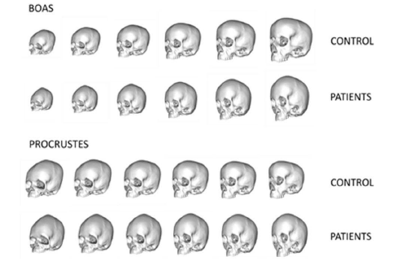
Results: 3D morphometric analyses Growth trajectories
Compared with controls, the growth of the skull in ACH was characterised by:
An overall retrusion of the midface
A forward tilting of the anterior aspect of the skull base
Leading to a tightening of the space between skull base and the posterior part of the maxilla
Facial shape in ACH was characterised by a deep nasal root and a maxillo-zygomatic retrusion
The orbits were vertically more elongated than in the control group
The skull vault was higher in the frontal region in older patients when compared with controls
More severe craniofacial phenotypes were associated with increasing patient age, predominantly regarding the midface with increased maxillary retrusion in older patients, and the skull base with closure of the spheno-occipital angle

Slide 8
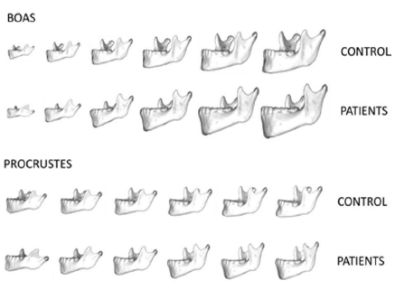
Results: 3D morphometric analyses Phenotypic aggravation with age
Boas coordinates of the mandible and age showed that mandible growth in ACH was characterised by
A backwards shift of the symphysis
Greater symphysis height
In older patients when compared with younger ones
Mandibular ramus was narrower and more vertical overall
The notch of the sigmoid was more profound
The coronoid process and the condyle were more vertically positioned
The segment between the retromolar region and the mandibular ramus was more concave
Growth anomalies also highlighted regressions by age, suggesting that they
corresponded to disease-specific phenomena

Slide 9
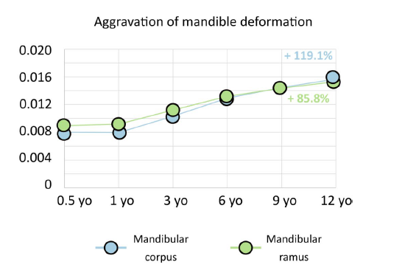
Results: 3D-CT assessment Phenotypic aggravation with age
Both the mandibular ramus and corpus showed comparable levels of phenotypic deformation between controls and patients
The most pronounced levels of aggravation were in the mandibular corpus (+ 119% of phenotypic deformation)
Overall, disparity in the levels of aggravation among landmarks was increased in older patients when compared with younger ones
The areas experiencing the greatest deformation were:
Within the coronoid process, the condyle and the gonion (mandibular ramus)
Within the most inferior part of the chin (mandibular corpus)
At the mandibular level, both the corpus and ramus showed shape modifications with age, with shortened anteroposterior mandibular length, as well as ramus and condylar region lengths

Slide 10
Results: Functional assessment
Polygraphic results and upper airway surgery
Sleep anomalies affected 80% of patients, with 33% patients having severe obstructive sleep apnoea syndrome (AHI >=10 events/hour)
Abnormal desaturations were observed in 13/15 patients
Apnoeas were mostly obstructive
Craniofacial phenotype and sleep disorders: anatomo-functional correlation
Greater AHI and OAHI values were both associated with more pronounced maxillary retrusion and retrognathism, and with smaller C1-C2 values
When maxillary and mandibular retrusion increased, SpO₂ min decreased
There was a significant correlation between the severity of maxillo-mandibular retrusion and
obstructive sleep apnoea syndrome (p<0.01)

Slide 11
Conclusion
ACH leads to different degrees of craniofacial morphological and functional severity
It shows, for the first time, that more severe craniofacial phenotypes occur in older patients than in younger ones
Suggesting an aggravation of craniofacial phenotypes during growth
It further demonstrates an anatomo-functional correlation between the severity of maxillo-mandibular retrusion and OSA
FGFR-related conditions due to activating mutations may soon benefit from medical treatments that will hopefully reduce the need for invasive surgical procedures
In this context, precise knowledge on the natural history of these conditions, including ACH, is crucial for adapting future treatment and assessing their efficiency, especially in resolving functional anomalies like OSA

