Slide 1

Growth in Achondroplasia Including Stature, Weight, Weight‑for‑Height and Head Circumference From CLARITY: Achondroplasia Natural History Study – A Multi‑center
Retrospective Cohort Study of Achondroplasia in the US
Adapted from Hoover‑Fong JE, Schulze KJ, Alade AY, Bober MB, Gough E, Hashmi SS,
Hecht JT, Legare JM, Little ME, Modaff P, Pauli RM, Rodriguez‑Buritica DF,
Serna ME, Smid C, Liu C, McGready J
Orphanet J Rare Dis 2021;16(1):522
doi: 10.1186/s13023-021-02141-4
Achondroplasia.expert is organized and funded by BioMarin. This material has been developed in conjunction with the Achondroplasia.expert Editorial Committee.
For Healthcare Professionals Only
© 2022 BioMarin International Ltd.
All Rights Reserved. EU-ACH-00375 02/22

Slide 2
Background
ACH is the most common genetic skeletal disorder causing disproportionate short stature
Common features include spinal stenosis, midface retrusion, macrocephaly, and a generalized spondylometaphyseal dysplasia
Growth references have previously been produced for ACH populations
  These curves were derived from a mix of longitudinal, cross-sectional, retrospective and/or prospectively collected data from populations ranging in size from 23 to 466 subjects, and collected as long ago as 1967
The CLARITY study has amassed what is likely to be the largest dataset of anthropometric measures in patients with ACH

Slide 3
Methods
CLARITY is a multi-centre natural history study
  To better understand the interactions and health outcomes of ACH complications
  One objective was to develop growth curves and reference tables for clinical use and research
Available retrospective anthropometry data were collected from ACH patients at 4 skeletal dysplasia centres in the US
  Including length/height, weight, and head circumference
Over 37,000 measures from 1,374 patients aged 0–75 years of age were compiled
Weight-for-age values >3 SD above the mean were excluded from the weight-for-height and weight-for-age curves to create a stricter tool for weight assessment in this population

Slide 4
Description of Subjects and Criteria to Include in Curves
 |  | Subjects (N=1341)
Sex, n (%) | Male | 690 (51.5)
 | Female | 651 (48.5)
Age, last encounter in years | Mean ± SD | 13.0 ± 12.4
 | Range | 0.0–75.2
 | Median (IQR) | 9.7 (4.5–16.7)
Demographic background | White | 78.4%
 | Hispanic/Latinx | 7.8%
 | Black | 6.1%
 | Asian | 5.8%
 | Native American | 0.2%
 | Hawaiian | 0.07%
 | unknown | 1.6%
 |  | N | Anthropometry data management
Gestation | Term, by GA or birth values | 1,023 | Include all anthropometry
 | Preterm, by GA or birth value | 157 | Include after 2 years
 | Undetermined GA | 161
Growth-modulating interventions | Limb lengthening | 17 | Include before surgery
 | GH deficiency | 4* | Include anthropometry
 | GH treatment | 2** | Include before treatment
 | Trial participant | 10 | Include before enrolment
37,349 anthropometric data points from 1,341 patients with ACH were included

Slide 5
Longitudinal Characteristics of Anthropometry Data for
1,341 Subjects With ACH
 | Birth |  | Birth to <3 years |  |  |  | 2–18 years |  |  |  | Birth to <5 years |  |  |  | >18 years
n | Subjects/points |  | Subjects |  | Points |  | Subjects |  | Points |  | Subjects |  | Points |  | Subjects |  | Points
Sex | M | F | M | F | M | F | M | F | M | F | M | F | M | F | M | F | M | F
Length/ height | 400 | 361 | 544 | 489 | 3024 | 2700 | 549 | 503 | 4011 | 3709 | 574 | 523 | 4102 | 3626 | 129 | 149 | 297 | 355
Weight | 471 | 421 | 550 | 493 | 3602 | 3107 | 531 | 484 | 4553 | 4263 | 570 | 521 | 4830 | 4177 | 129 | 148 | 475 | 519
Head | 232 | 189 | 498 | 441 | 2643 | 2331 |  |  |  |  | 534 | 489 | 3449 | 3012
 | Length/height N (% total population) | Weight N (% total population) | Head circumference N (% total population)
> 3 points | 977 (71.1) | 968 (70.5) | 879 (64.0)
> 5 points | 799 (58.2) | 823 (60.0) | 699 (50.9)
≥10 points | 510 (37.1) | 544 (39.6) | 385 (28.0)
Over half of this ACH cohort contributed ≥5 data points in all 3 growth categories;
approximately one-third contributed ≥10 data points in each parameter

Slide 6
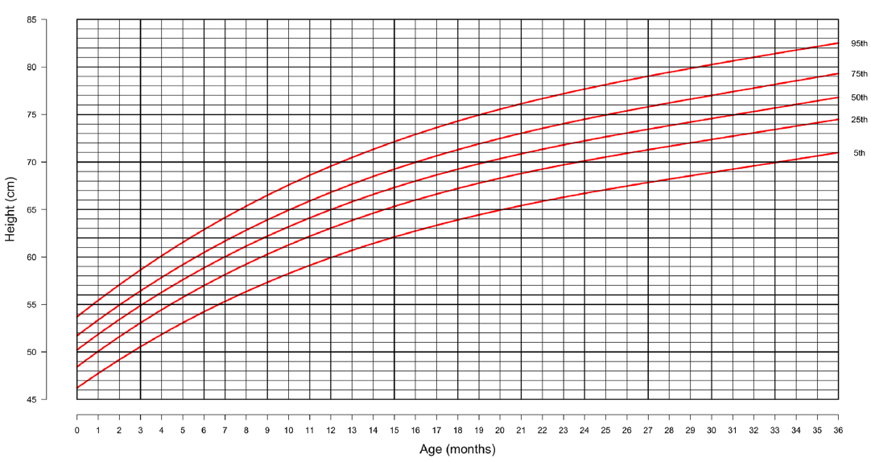
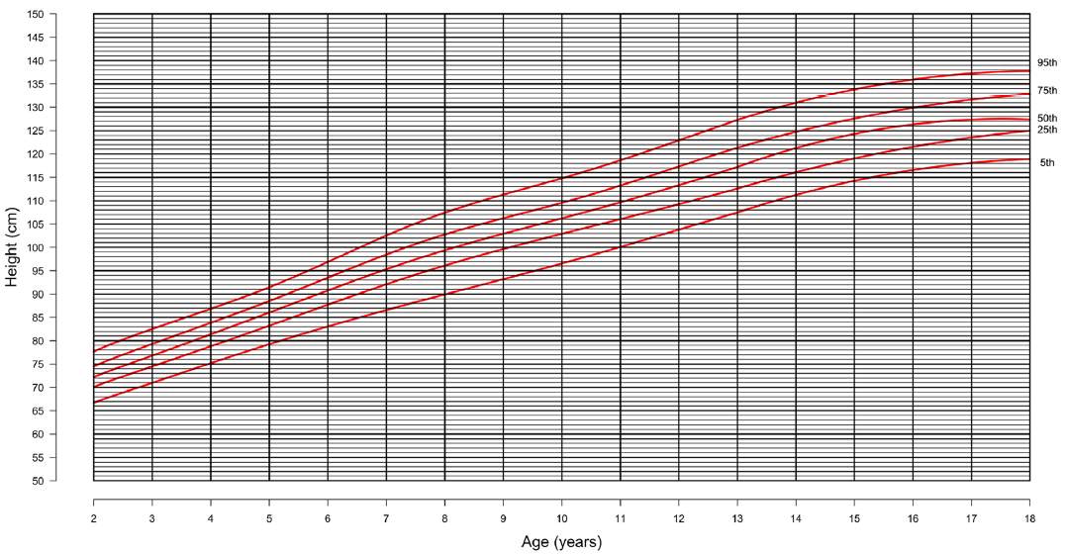
Stature for Age in Males With ACH
Males 0–36 months
Males 2–18 years
Based on visual inspection of the most recently published height-for-age curves, median height was similar across populations at 5 and 10 years of age, ranging from 86–88 cm in boys at 5 years and 106–108 cm at 10 years

Slide 7
Stature for Age in Females With ACH
Females 0–36 months
Females 2–18 years
Based on visual inspection of the most recently published height-for-age curves, median height was similar across populations at 5 and 10 years of age, ranging from ~85 to 87 cm at 5 years and 104–106 cm at 10 years in females

Slide 8
Weight for Age in ACH
Using average weight values in the first year of life, observed gain in males was:
  21.2 g per day in Month 1
  21.6 g per day in Months 1–3
  10.8 g per day in Months 3–6
  7.4 g per day in Months 6–12
In females, observed average weight gain was:
  21.2 g per day in Month 1
  16.5 g per day in Months 1–3
  14.0 g per day in Months 3–6
  11.8 g per day in Months 6–12
Males 0–36 months
Females 0–36 months
Males 2–18 years
Females 2–18 years
Exclusion of weight-for-age values beyond 3 SD in these novel curves
provide a stricter tool for weight assessment in this population

Slide 9
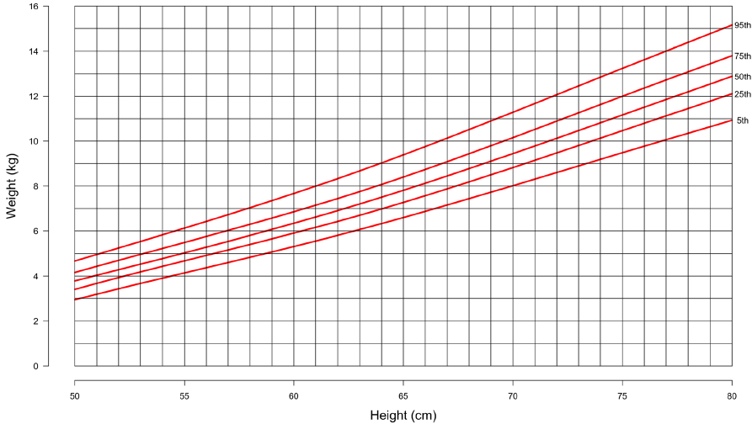
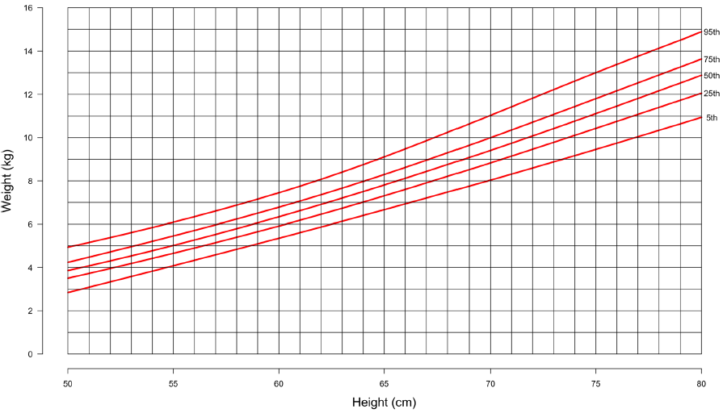
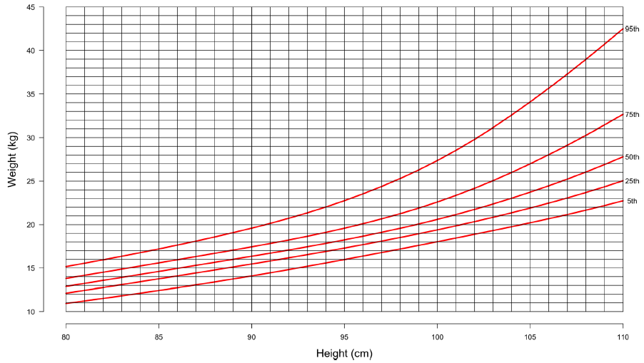
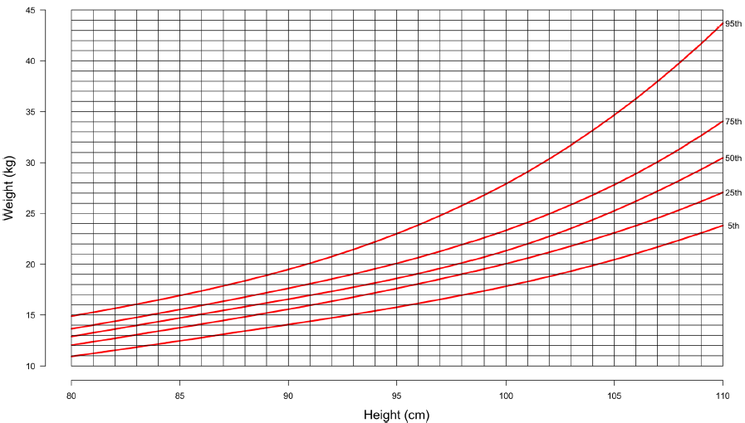
Weight for Stature in ACH
Males 50–80 cm in height
Females 50–80 cm in height
Males 80–110 cm in height
Females 80–110 cm in height
New weight-for-stature charts are proposed to help clinicians integrate information on weight and height to improve guidance for achieving appropriate weights in a population prone to obesity

Slide 10
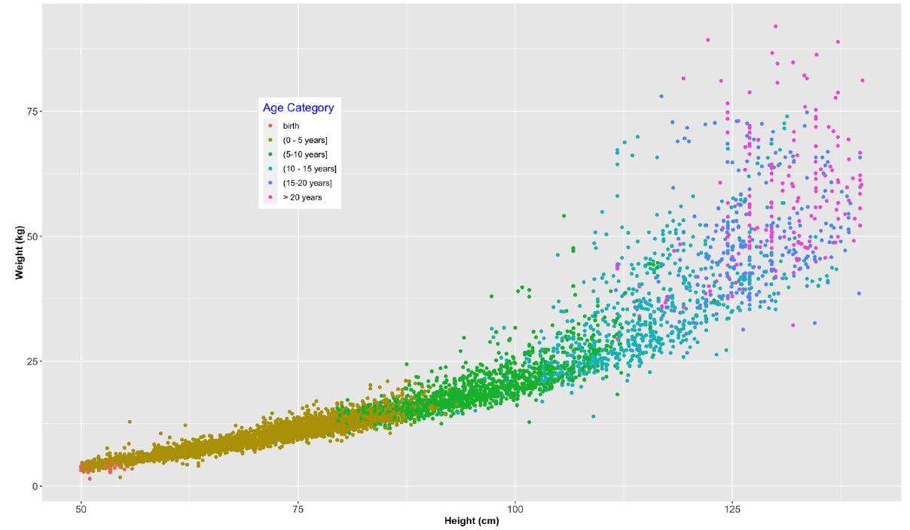
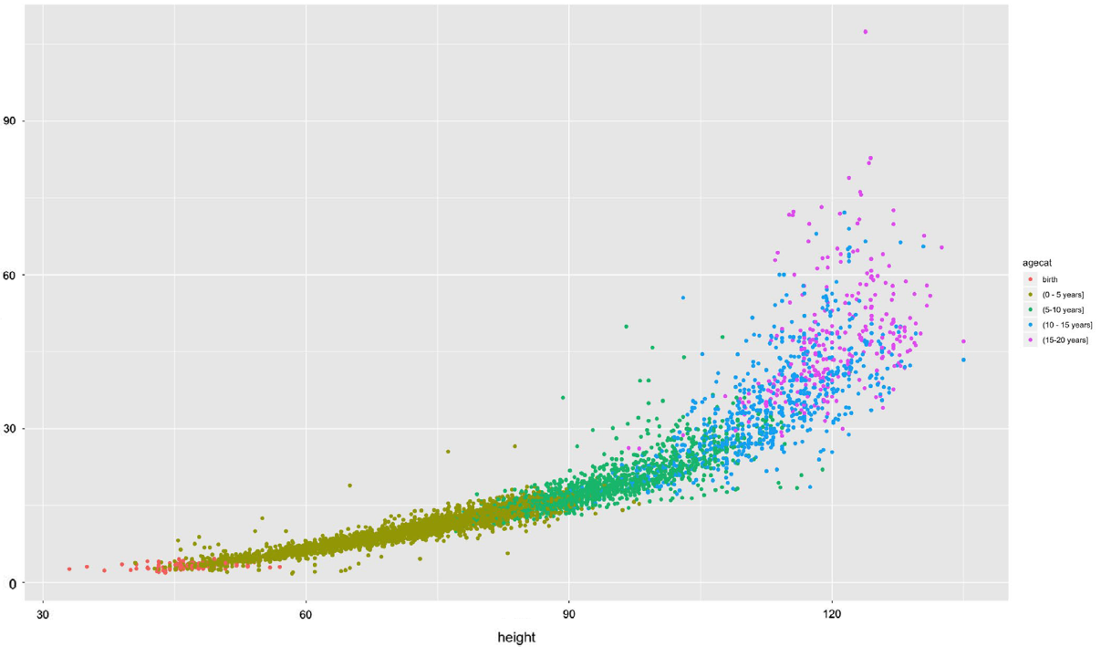
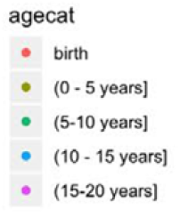
Weight Versus Height by Age Group
Males
Females
Height (cm)
These novel weight-for-height curves are divided into 3 groups based on height
to allow for optimal resolution for clinical use

Slide 11
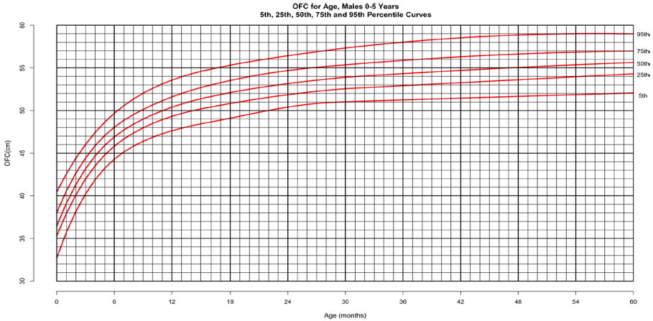
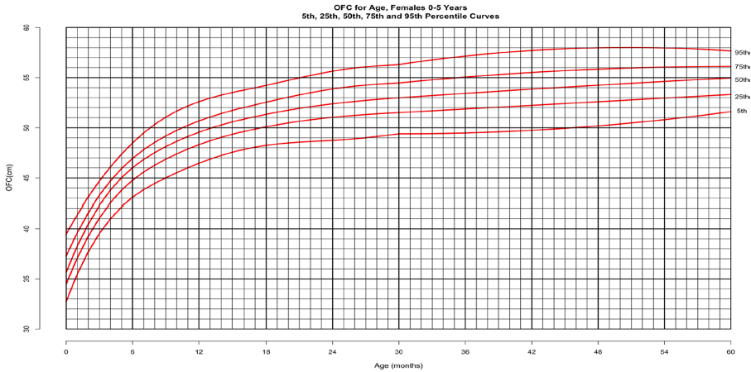
Head Circumference for Age in ACH
Males 0–5 years
Females 0–5 years
In this ACH cohort, there is minimal head circumference growth after 3 years of age. 90% of median head circumference for 5-year-olds is achieved at 13 months of age for males, and 12 months for females

Slide 12
Conclusion
Data from CLARITY were used to construct new curves for length/height-for-age,
weight-for-age, head circumference-for-age, and weight-for-height in patients with ACH
  ACH-specific growth curves are essential for clinical care of growing infants and children with this condition
  In an effort to provide prescriptive, rather than purely descriptive, references for weight in this population, extreme values were omitted from the weight-for-age and weight-for-height curves
Mean and SD values of weight, stature and head circumference in a tabular form at 1 month intervals from birth through 18 years are offered for the first time for clinical and research applications
New weight-for-stature charts may help improve guidance in a population prone to obesity
This cohort may be studied with other global populations (Europe, Argentina, Australia, Japan) to gain further insight into environmental or ethnic influences on growth
The cohort may also be contrasted to individuals and populations who undergo novel therapies and interventions to ascertain the effect of those treatments

