Slide 1
Perioperative Complications Following Spine Surgery in Adult Patients with Achondroplasia
Adapted from: Chan JL, Quintero-Consuegra MD, Kanim LEA, Kropf MA, Bernstein R, Perry TG, Walker CT, Danielpour M, Tuchman A
Global Spine Journal 2023 DOI: 10.1177/21925682231157373
Achondroplasia.expert is organized and funded by BioMarin. This material has been developed in conjunction with the Achondroplasia.expert Editorial Committee.
For Healthcare Professionals Only © 2022 BioMarin International Ltd. All Rights Reserved. EU-ACH-00776 03/23

Slide 2
Background
Due to the altered osteogenic development of the spine, ACH patients may develop spinal stenosis leading to spinal cord and/or cauda equina compression
20–50% of adults with ACH have symptomatic spinal stenosis (compared to just 11% in the general population), and up to 78% of those have neurologic sequelae
Given the unique anatomy that leads to neurologic deficit and injury, patients with ACH are at increased risk for complications during surgical intervention
Specifically, individuals with ACH may be at increased risk for dural tears due to altered connective tissue development, decreased epidural fat, and smaller spinal canal
This study aimed to describe common complications and risk factors during spine surgery in patients with ACH

Slide 3
Study Design
Retrospective review at one institution in the USA between 2007 and 2021
55 ACH patients (>16 years) who underwent spine surgery
95 surgical encounters evaluated for durotomy, postoperative neurologic deficit, wound compromise, medical complications, and return to operating room
Statistical analysis included evaluation of relationships across complications
Multivariable analysis using logistic regression was performed to account for patient characteristics

Slide 4
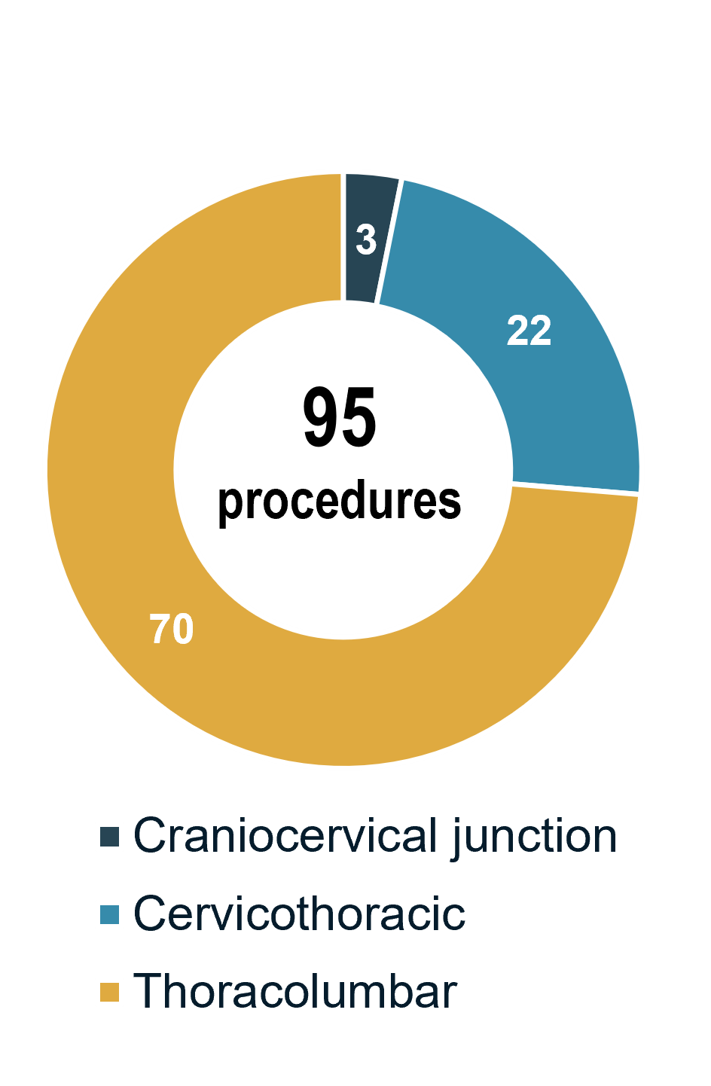
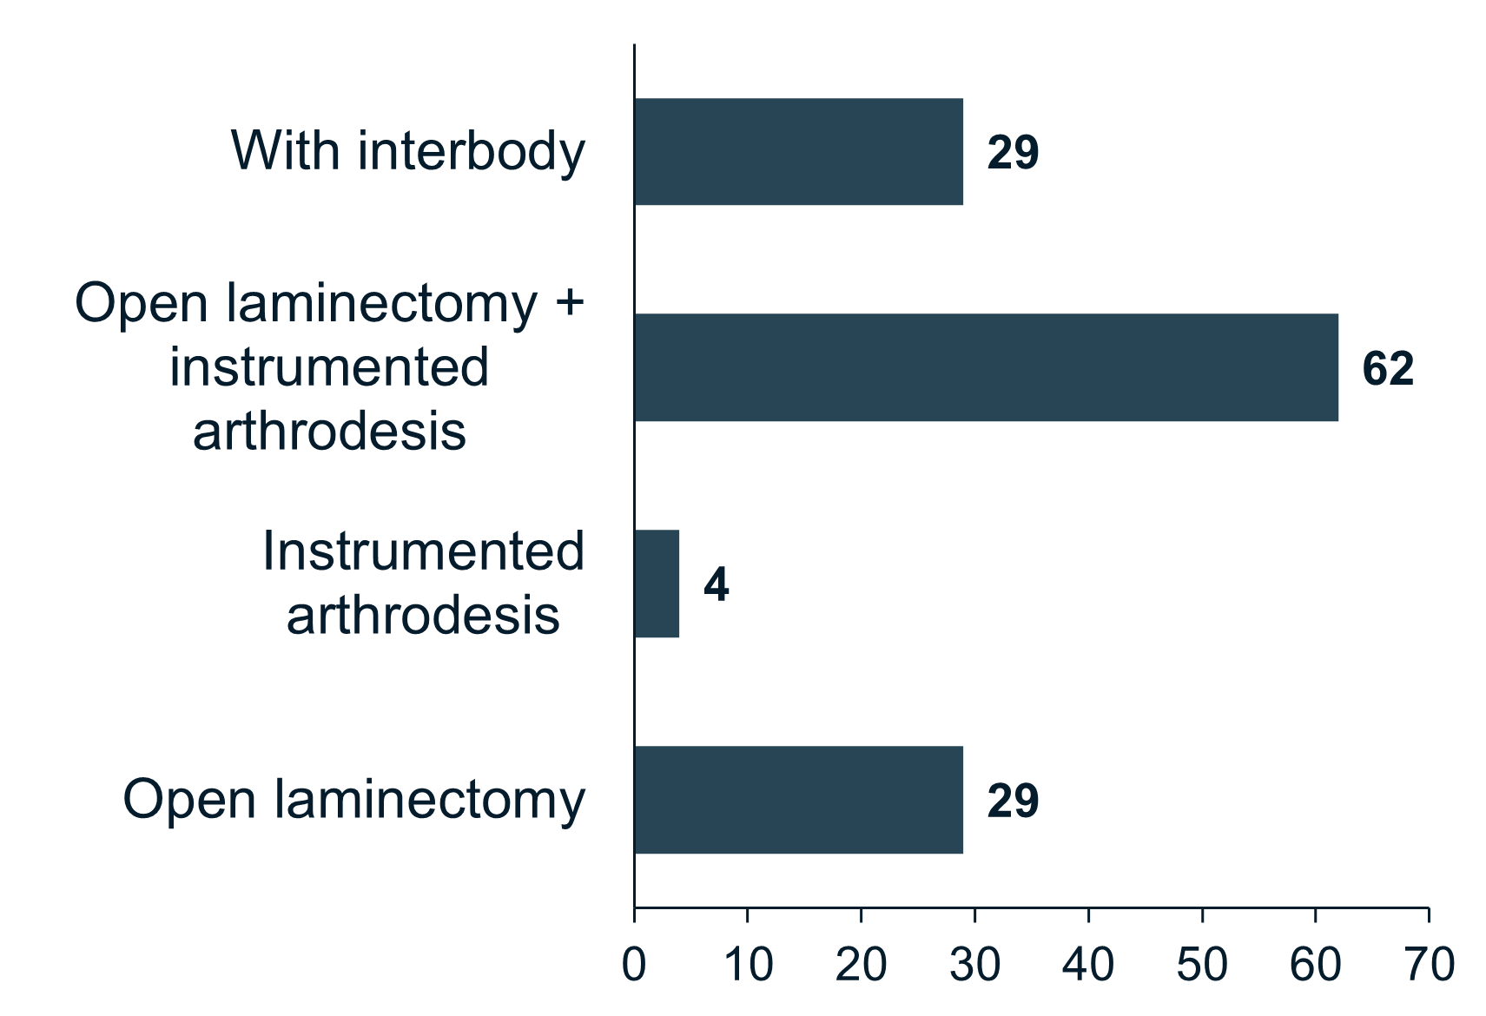
Demographics and General Characteristics of Surgical Encounters
Demographic
Surgical location (n):
Surgical type (n):
58% female
Mean age: 44 years
Mean BMI: 35
LOS: 6.5 days
A total of 55 patients with ACH who underwent 95 surgeries were included in the final patient cohort

Slide 5
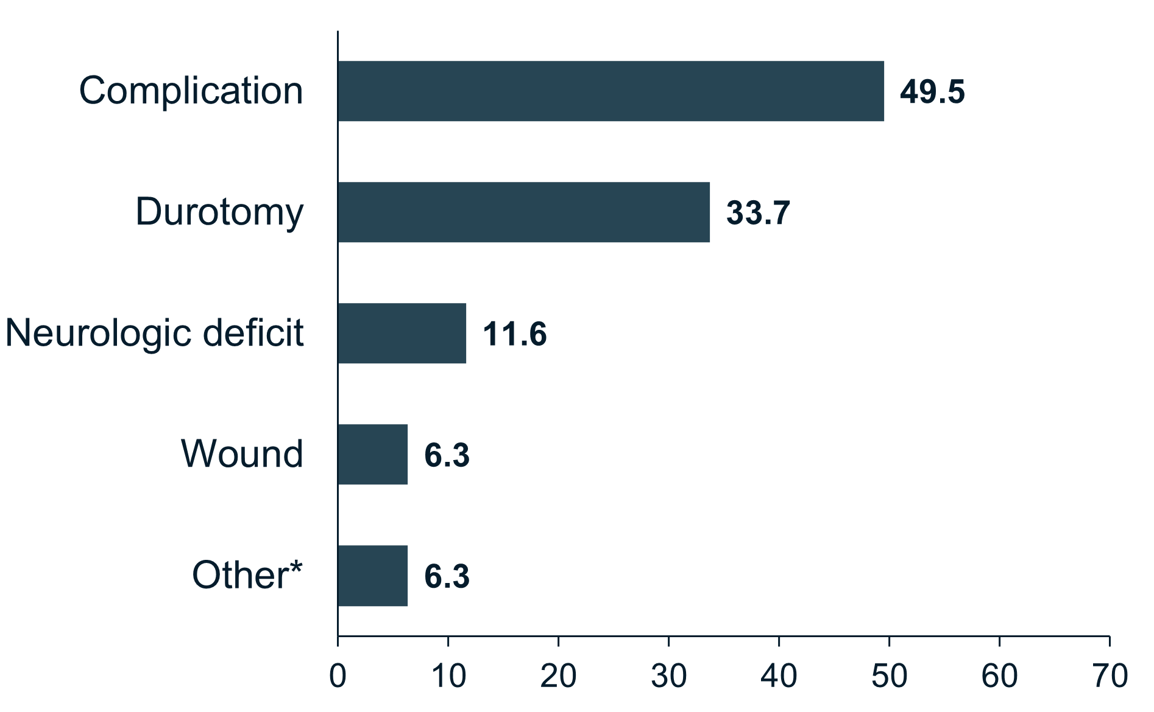
Spine Surgery Encounter Complications
Type of complications (%):
Greatest number of complications occurred in TL region
60.0% compared to 18.2% and 33.3% for CT and CCJ, respectively
Chronologically later surgery had decreased complications
Durotomies occurred only in TL surgeries (45.7%)
No patients suffered MI or DVT
49.5% of surgeries involved a complication

Slide 6
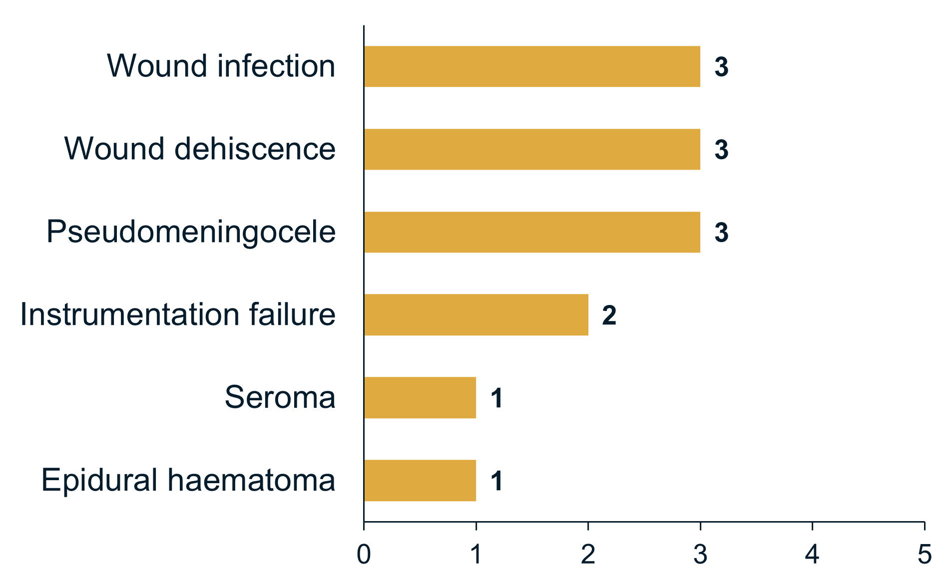
Return to the Operating Room
Indications for return to operating room (n):
13.7% of encounters required return to the operating room
Average days between index surgical encounter and return to operating room: 36.2 days
SD 38.6; range 3–133
13.7% of surgeries required return to the operating room

Slide 7
Risk Factors for Complications
Male sex, lower BMI, and thoracolumbar surgery had increased incidence of durotomy (P<0.05, P <0.01)
Neurologic deficits were associated with increased age (mean 57.3 vs 42.6 years, P<0.01)
Further subgroup analysis of laminectomy and instrumented arthrodesis surgeries also demonstrated increased age (>49 years, P<0.001)
Chronologically later surgical encounters in this cohort had decreased complications (P<0.05); this relationship was stable when controlling for age and surgical levels
Increased age and history of prior spine surgery were not related to an increased risk of complication (NS), where age and number of surgical levels were positively related to year chronologically
Given that patients chronologically later in the series had decreased AEs, surgeon experience may be key to improving postoperative complications in patients with ACH

Slide 8
Conclusions
There have been analyses of patients with skeletal dysplasia following spinal surgery
But this is the largest modern series evaluating perioperative complications and potential risk factors in this unique patient population
Findings showed adult ACH patients undergoing surgery chronologically later were at a decreased risk for complications
Surgeon experience may be key to improving postoperative complications
Thoracolumbar surgeries were at the greatest risk for durotomies
Male sex was a risk factor for durotomy, while age was a risk factor for neurologic deficit
Potential for adverse surgical events should be considered when evaluating patients with ACH for spine surgery

